Slide 1



CERTIFICATE GENERATION SYSTEM

Slide 2
GROUP4
INTRUCSTOR: MS. LÊ THỊ MINH LOAN
STUDENTS
PHẠM HOÀNG TÂM
A18097
A18118
NGUYỄN TRƯỜNG GIANG
A18103
NGHIÊM ANH TÚ
A18120
TRẦN MỘT EM

Slide 3
Project Ref. No. | Project Title: | Activity Plan Prepared By: |  | Date of Preparation of Activity Plan:
Task | Description | Planned Start Date | Actual Start Date | Actual Days | Teams Members Names | Status
1 | Form 3 (Project Plan) | 10-Sep-2019 | 12-Sep-2019 | 3 | Phạm Hoàng Tâm | Completed 100%
2 | Form 6 (ER) | 13-Sep-2019 | 16-Sep-2019 | 4 |  | Completed 100%
3 | Form 5 (Interface Design) | 17-Sep-2019 | 19-Sep-2019 | 3 |  | Completed 100%
4 | Form 7(DFD) | 20-Sep-2019 | 23-Sep-2019 | 4 |  | Completed 100%
5 | Form 9 (Task Sheet) | 10-Sep-2019 | 17-Sep-2019 | 37 |  | Completed 100%
6 | Manage Students | 24-Sep-2019 | 27-Sep-2019 | 4 |  | Completed 100%
7 | Manage Certificate | 28-Sep-2019 | 2-Oct-2019 | 5 |  | Completed 100%
8 | Manage Authentication | 3-Oct-2019 | 4-Oct-2019 | 4 |  | Completed 100%
9 | Manage Admin&CC | 5-Oct-2019 | 8-Oct-2019 | 4 |  | Completed 100%
10 | Manage issued certificate | 9-Oct-2019 | 11-Oct-2019 | 3 |  | Completed 100%
11 | Manage Report | 11-Oct-2019 | 12-Oct-2019 | 3 |  | Completed 100%
12 | Search and Verify Student Profile | 12-Oct-2019 | 13-Oct-2019 | 2 |  | Completed 100%
13 | Form 2B (CRS) | 10-Sep-2019 | 12-Sep-2019 | 3 | Nguyễn Trường Giang | Completed 100%
14 | Form 5 (Interface Design) | 13-Sep-2019 | 15-Sep-2019 | 3 |  | Completed 100%
15 | Form 7 (DFD) | 16-Sep-2019 | 19-Sep-2019 | 4 |  | Completed 100%
16 | Form 8 (Coding Standards) | 19-Sep-2019 | 20-Sep-2019 | 2 |  | Completed 100%
17 | Manage Course | 20-Sep-2019 | 27-Sep-2019 | 8 |  | Completed 100%
18 | Manage Exam | 28-Sep-2019 | 10-Sep-2019 | 13 |  | Completed 100%
19 | Manage Subject | 9-Oct-2019 | 13-Oct-2019 | 5 |  | Completed 100%
20 | Form 2A (CRS) | 10-Sep-2019 | 12-Sep-2019 | 3 | Nghiêm Anh Tú | Completed 80%
21 | Form 5 (Interface Design) | 17-Sep-2019 | 19-Sep-2019 | 3 |  | Completed 80%
22 | Form 7 (DFD) | 20-Sep-2019 | 23-Sep-2019 | 4 |  | Completed 80%
23 | Mange Grade | 24-Sep-2019 | 2-Oct-2019 | 9 |  | Completed 90%
24 | Manage Teachers | 3-Oct-2019 | 13-Oct-2019 | 11 |  | Completed 90%
25 | Form 1 (Problem Definition) | 10-Sep-2019 | 12-Sep-2019 | 3 | Trần Một Em | Completed 100%
26 | Form 4 (GUI Standards) | 13-Sep-2019 | 16-Sep-2019 | 4 |  | Completed 100%
27 | Form 7 (DFD) | 17-Sep-2019 | 19-Sep-2019 | 3 |  | Completed 100%
28 | Form 5 (Interface Design) | 20-Sep-2019 | 23-Sep-2019 | 4 |  | Completed 100%
 |  |  |  |  |  | Completed 100%
29 | Manage Class | 24-Sep-2019 | 30-Sep-2019 | 7
30 | Manage Teaching | 1-Oct-2019 | 6-Oct-2019 | 6 |  | Completed 100%
31 | Manage Personal Account | 7-Oct-2019 | 13-Oct-2019 | 7
 |  |  |  |  |  | Completed 100%

Slide 4
PROBLEM DEFINITION
DEFINE
The ABC Institute's certification office is the place to register for courses and issue certificates to students, previously all work was done manually and time-consuming, due to the increasing needs of students. Many manual jobs no longer meet the needs of the job, so we need to advance our work by creating an online certification system. Creating and certifying students who have completed the course, all of the work here is done in the most advanced way from input to output. The registration process is fast and convenient, students register and modify information online on the system and the payment is also made in many different forms, students can be assured after completing the course, the certificate issuance in the shortest time and ensuring student information is accurate, minimizing information errors as well as the time of issuing certificates at the lowest level. To done these works, we decided to deploy the Client-Server model for Certificate Generation System of the ABC institute. The certificate system will build a LAN network and apply the Client-Server model. The server is a centralized place for managing tasks and hosting, managing clients. Server is also the place to store accounts of Admin, Certificate Cell, Student with different access rights to the system. Client computers will be required to login when they want to access the system. The model will help improve information security.

Slide 5
LIST OF INPUT TO THE SYSTEM
INPUT
Certificate Cell information (Certificate ID, Certificate Name)
Student information (Student ID, Name, Address, DOB, Gender, Phone, Address)
Admin information (ID, Name, Address, DOB, Gender, Phone, Role)
Teachers(TeacherID, Name, DOB, Gender, Phone, Address, Academic Level, Technique)
Course(CourseID, Course Name)
Marks of students
Class of students (Class ID, Class Name)
Subjects of Course (Subject ID, Subject Name, Fee)
Grade of Certificate(GradeID, Grade Name)

Slide 6
LIST OF OUPUTS EXPECTED FROM THE SYSTEM
OUTPUT
Personal information of students (Marks, Certificate, Payment status, …)
Report and statistic of Admin & Certificate Cell, Students, Teachers, Course, Exam, Class, Subject, Certificate
List of Admin & Certificate Cell, Students, Teachers, Exam, Class, Subject, Grade, Teaching, Course, Certificate
List or report of students who are eligible and not yet eligible to complete the course
Student list or report has received the certificate

Slide 7
OVERVIEW OF PROCESSES INVOLVED IN THE SYSTEM
OVERVIEW
Login, Logout (The login portal appears every time you enter the system, asking the user to confirm the access. The system contains three login: Admin, Certificate Cell, Student Login).
Admin:
Manage Admin & Certificate Cell Account
Manage Students
Manage Teachers
Manage Class
Manage Grade of Certificate
Manage Course
Manage Subjects
Manage Exam
Manage Teaching
Manage Certificate
Statistics and reports

Slide 8
OVERVIEW
Certificate Cell:
Search and verify Students Profile
Manage issued certificate for the students
Students:
View their payments status for the course
View Result form.
OVERVIEW OF PROCESSES INVOLVED IN THE SYSTEM

Slide 9
CUSTOMER’S ACCEPTANCE CRITERIA
S.No | Customer’s Acceptance Criteria
1. | Login, Logout
2. | The system contains three login: Admin, Certificate Cell, Student Login
3. | Create a registration form for students
4. | Update Database
5. | Create lists or report from Database
6. | Create Fees Structure
7. | Marks Entry for subjects
8. | Manage the certificate for the students
9. | Verifies the status of the students
10. | Check whether the students have given the all exam
11. | Generate the appropriate message to the students
12. | Students can view their registration and certification information.
13. | Students can check the balance remained and result form
14. | Data is backed up, updated regularly.

Slide 10
PROJECT VISION
OBJECTIVES
Provide Certificate Generation System for ABC Institute.
Build management system help computerize the Certificate Department. And to overcome the problems that the ABC Institute is facing.
Increase efficiency and accuracy in student management.
Save time, money and minimize management staff.

Slide 11
SCOPE
Depending on the decision taken by the management ABC Institute, following are the requirements based on which the Certificate Generation System needs to be developed:
Build Certificate Generation System based on client-server model
The system will be maintained and repaired if any problems occur with the system
The system has the functions as stated:
Login, Logout
The system contains three login: Admin, Certificate Cell, Student Login
Create a registration form for students
Update Database
Create lists or report from Database
Create Fees Structure
Marks Entry for subjects
Produce the certificate for the students
Verifies the status of the students
Check whether the students have given the all exam
Generate the appropriate message to the students
Students can view their registration and certification information.
Students can check the balance remained and result form
Data is backed up, updated regularly.

Slide 12
MAJOR PROJECT MILESTONES
Analyzing (from 10-Sep-2019 to 15-Sep-2019): analyze and find solutions to meet with the requirement of the problem.
Designing (from 16-Sep-2019 to 23-Sep-2019): start designing database and the overall interface for the project after analyzing the problem.
Coding (from 24-Sep-2019 to 13-Oct-2019): begin coding after designing database and interface.
Testing (from 14-Oct-2019 to 17-Oct-2019): test all the functions to make sure that everything run correctly.

Slide 13
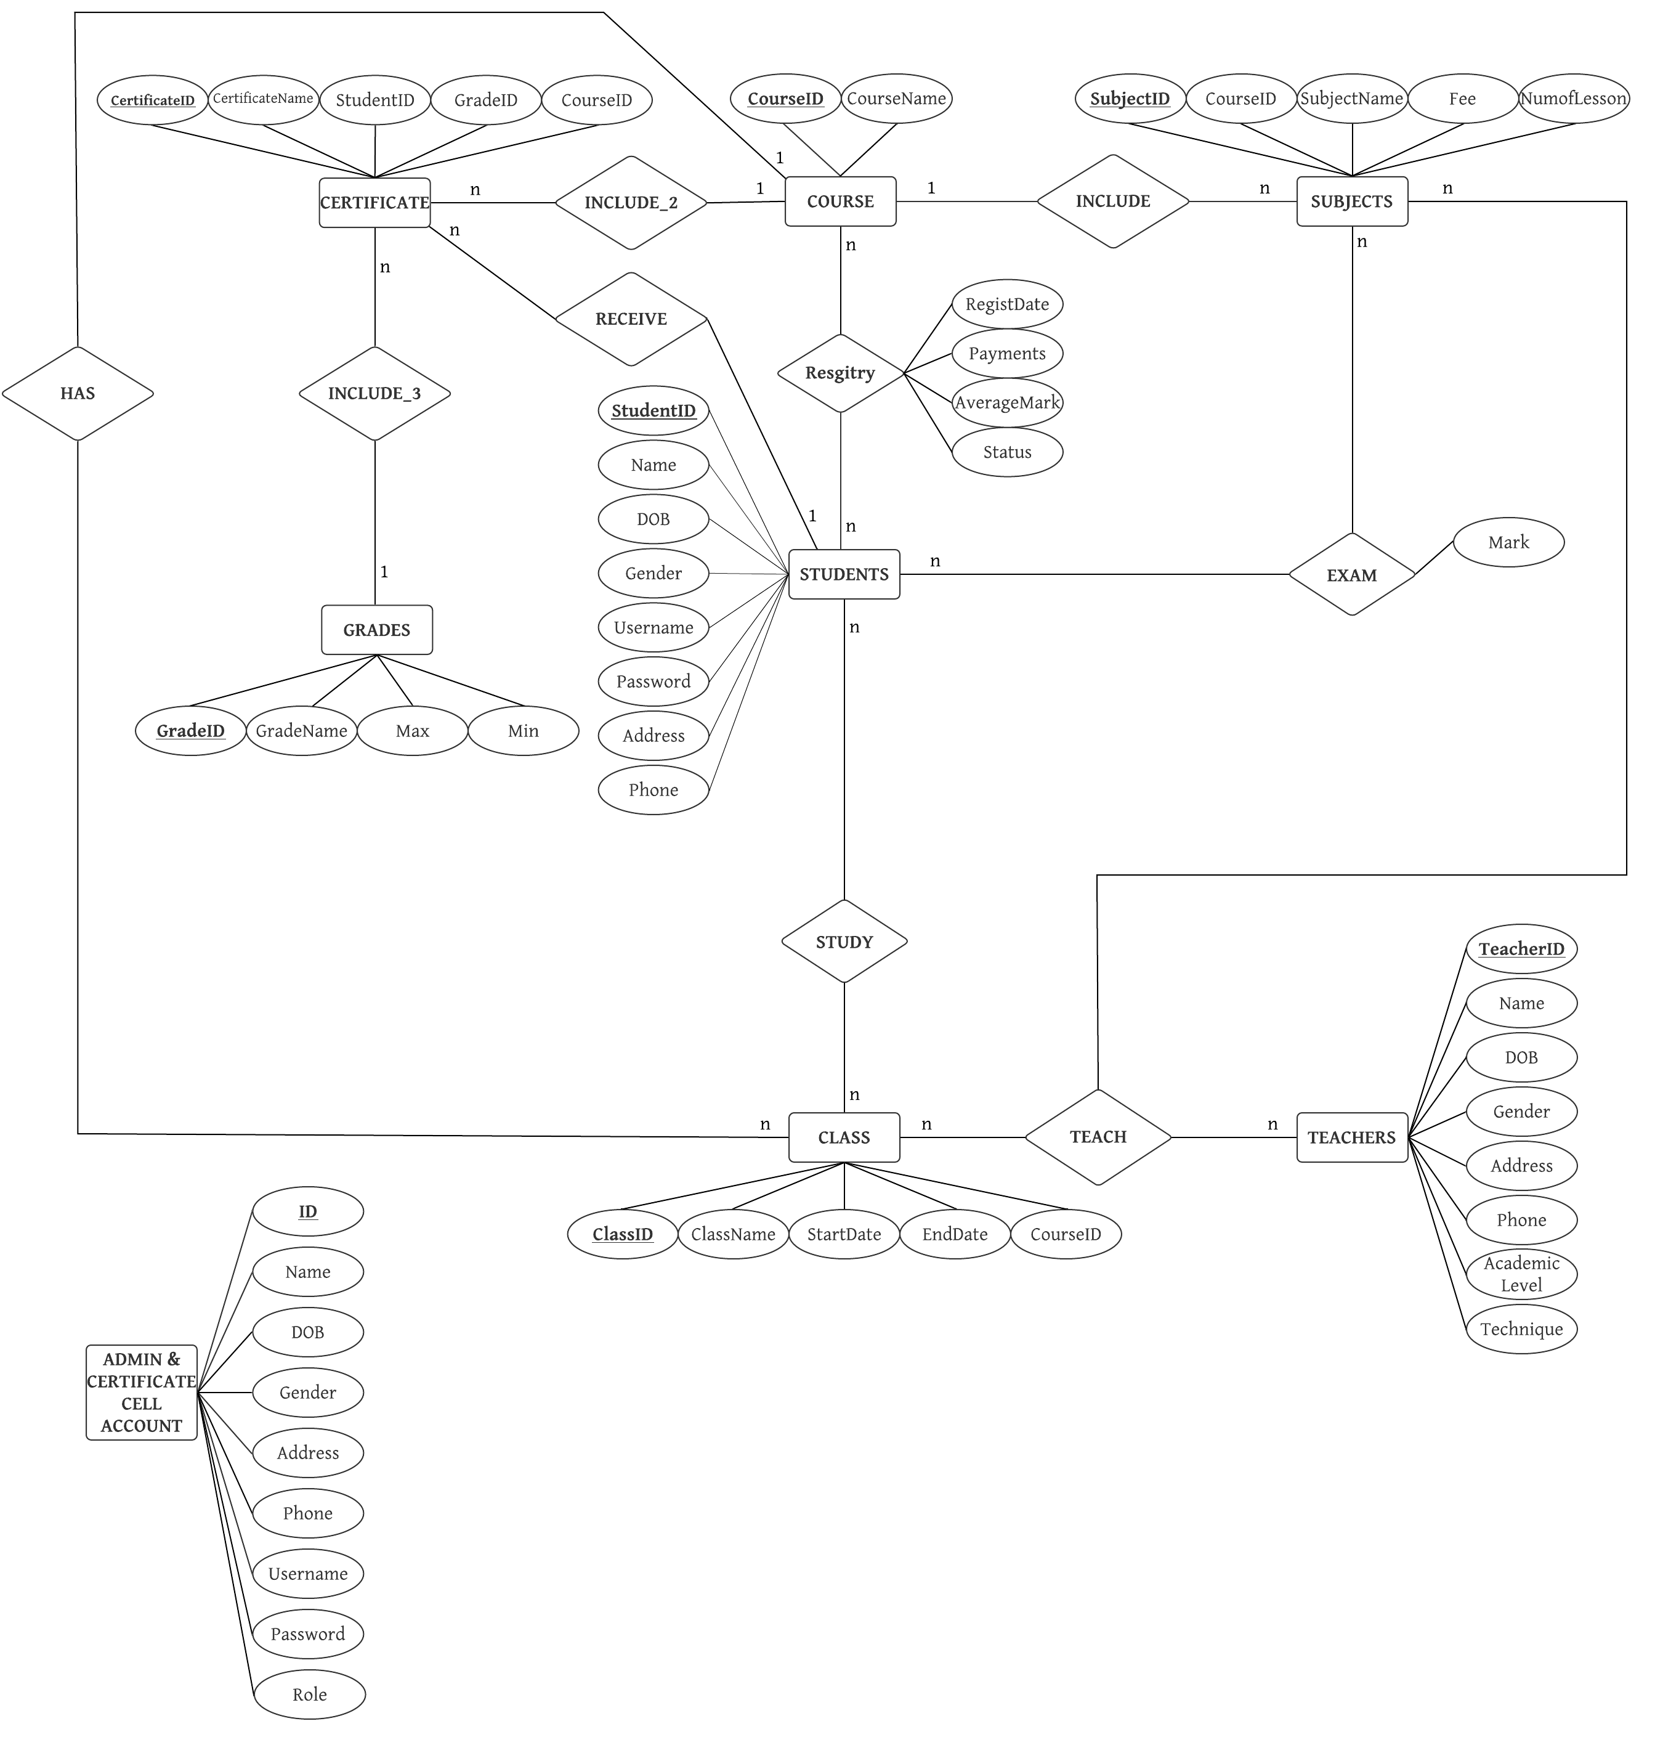
ENTITY RELATIONSHIP MODEL

Slide 14


DFD
DATA FLOW DIAGRAM

Slide 15
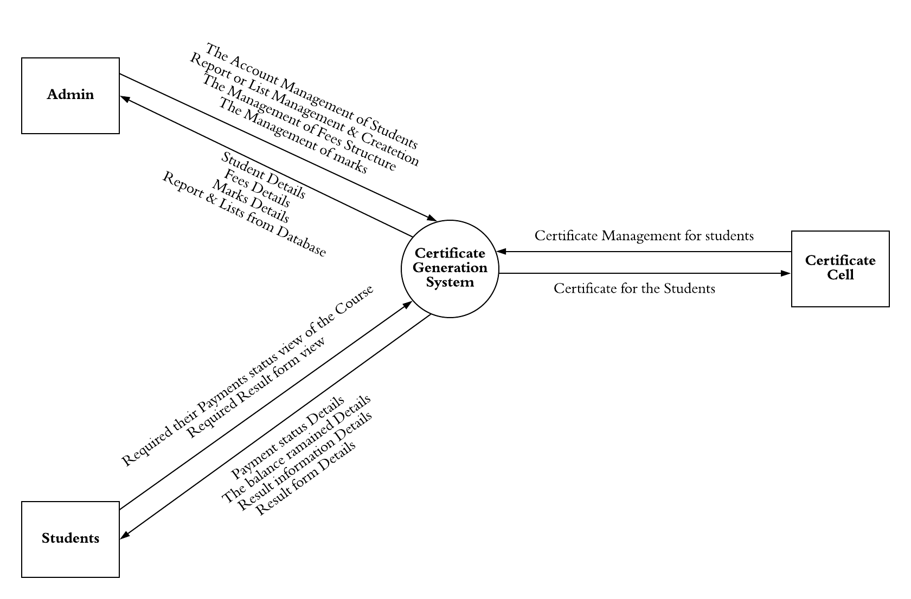
DFD LEVEL 0

Slide 16
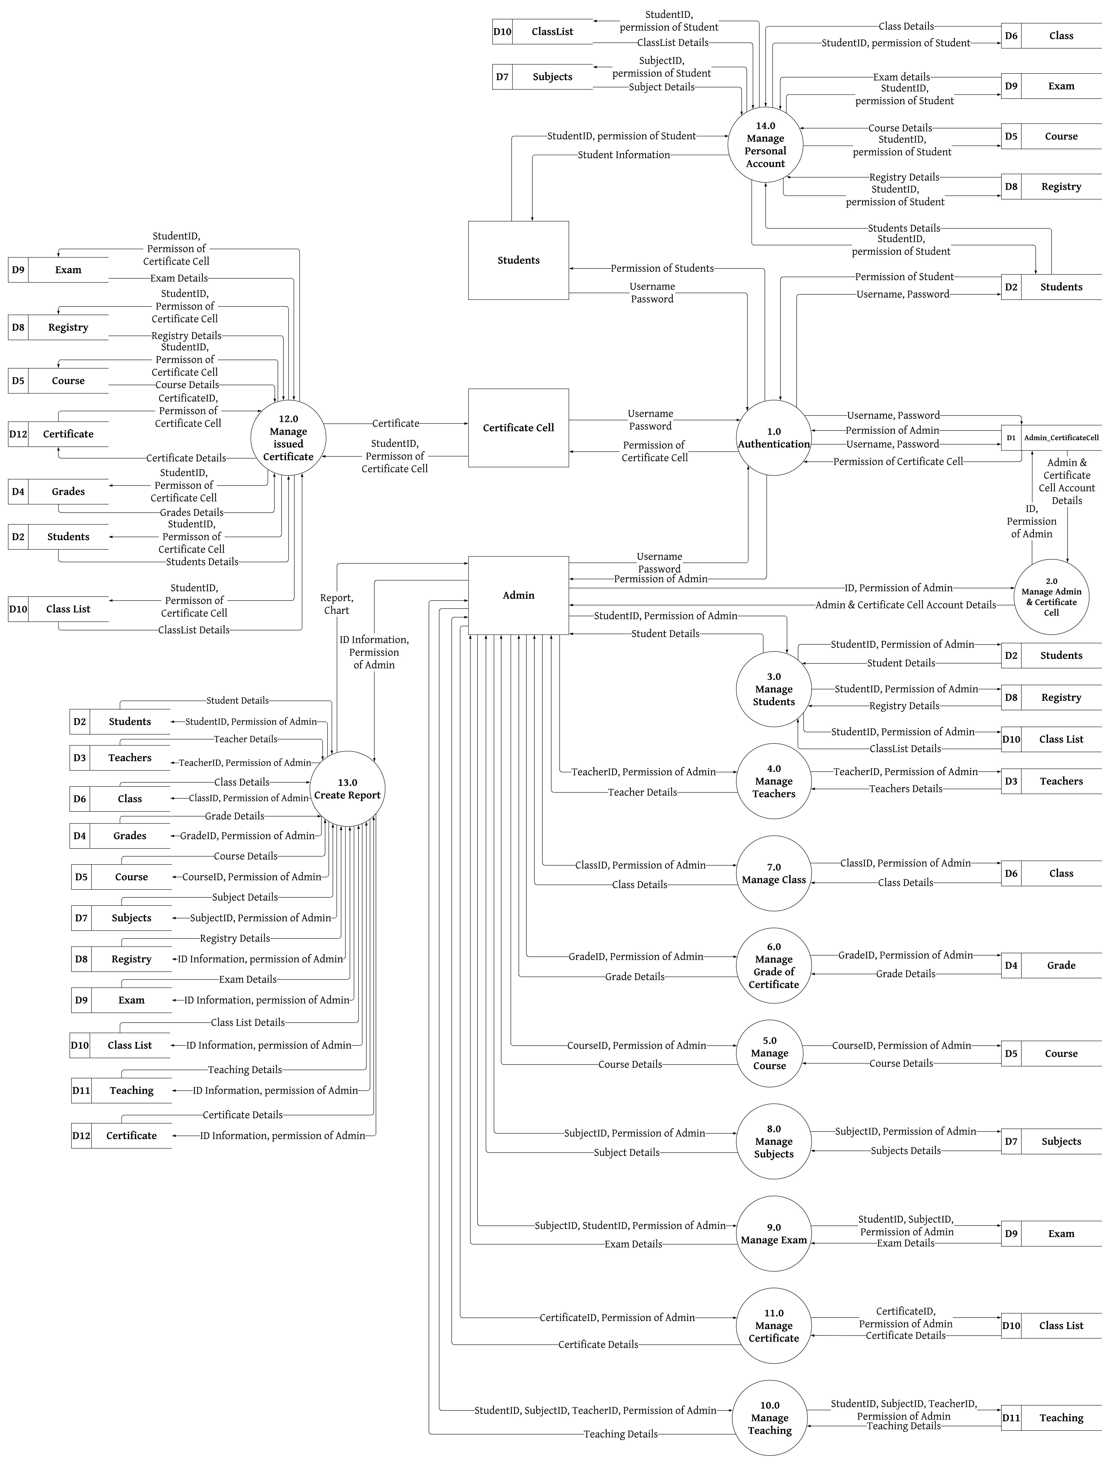
DFD LEVEL 1

Slide 17

MANAGE
AUTHENTICATION

Slide 18
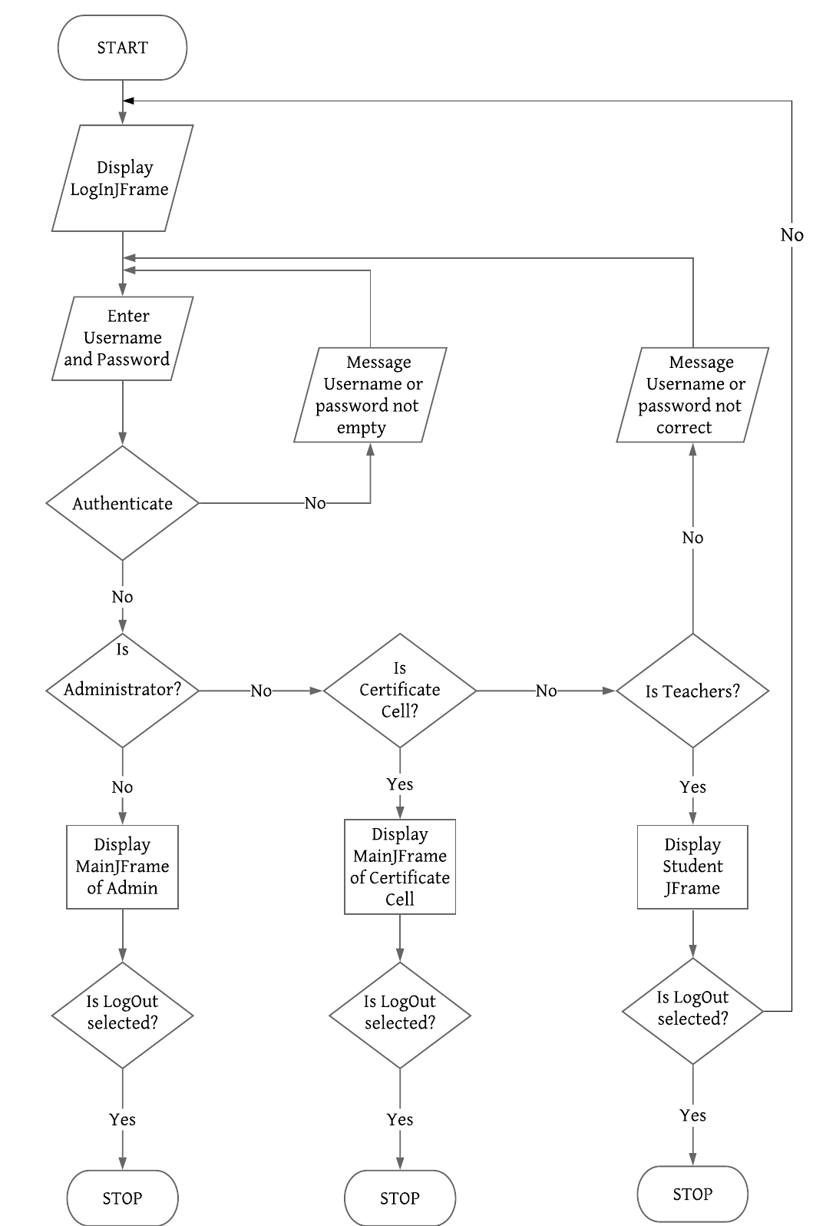
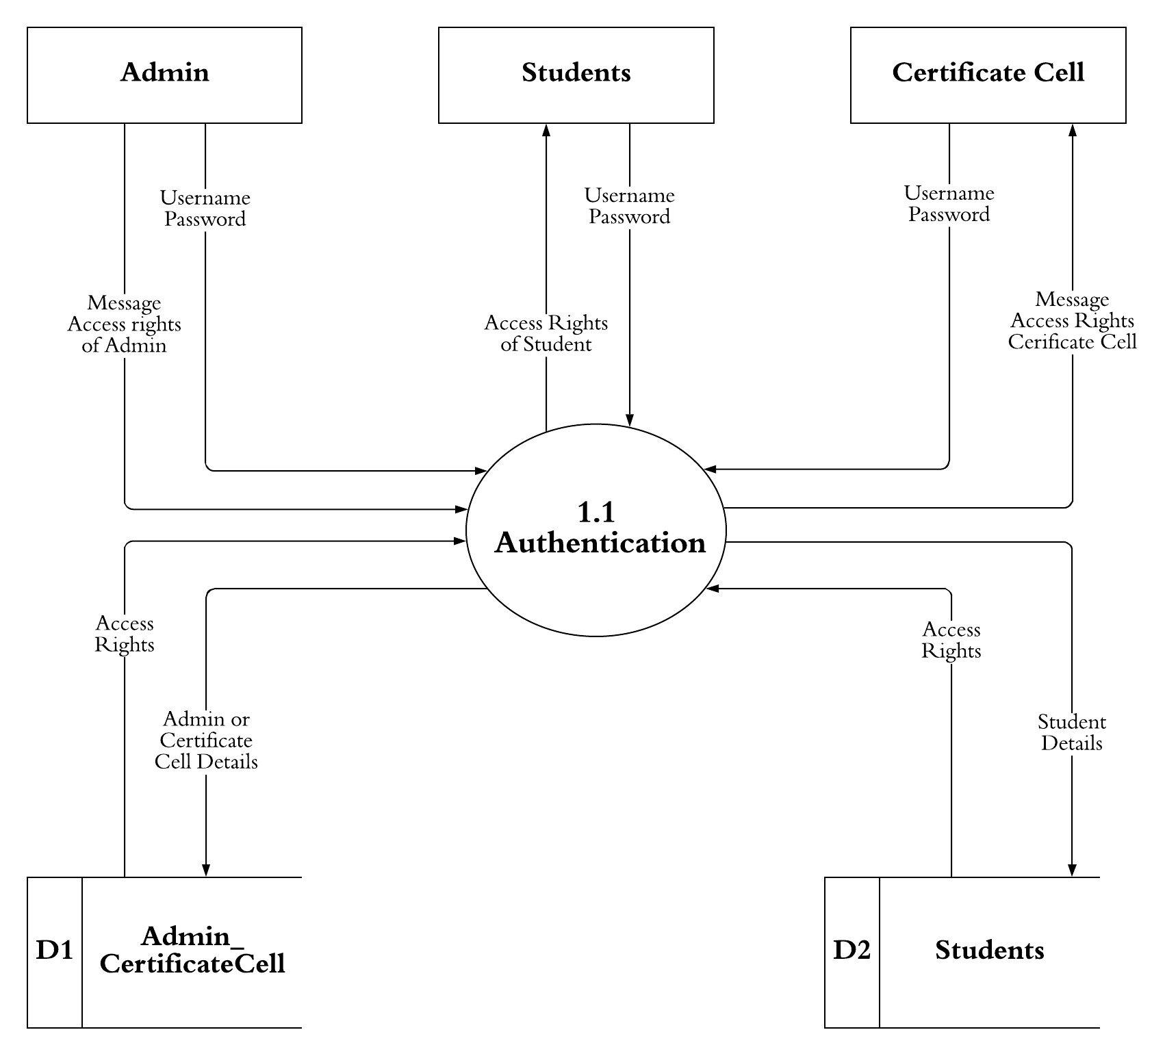
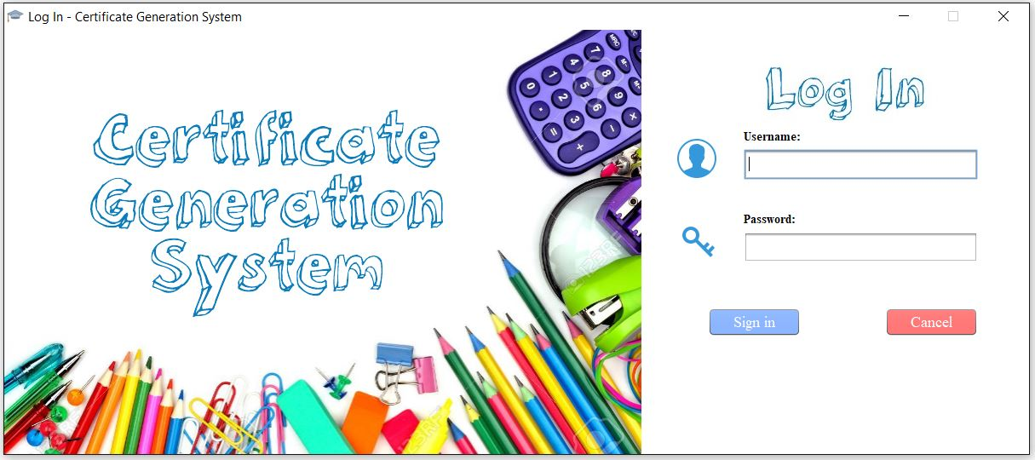

Slide 19

MANAGE
ADMINISTRATOR & CERTIFICATE CELL

Slide 20
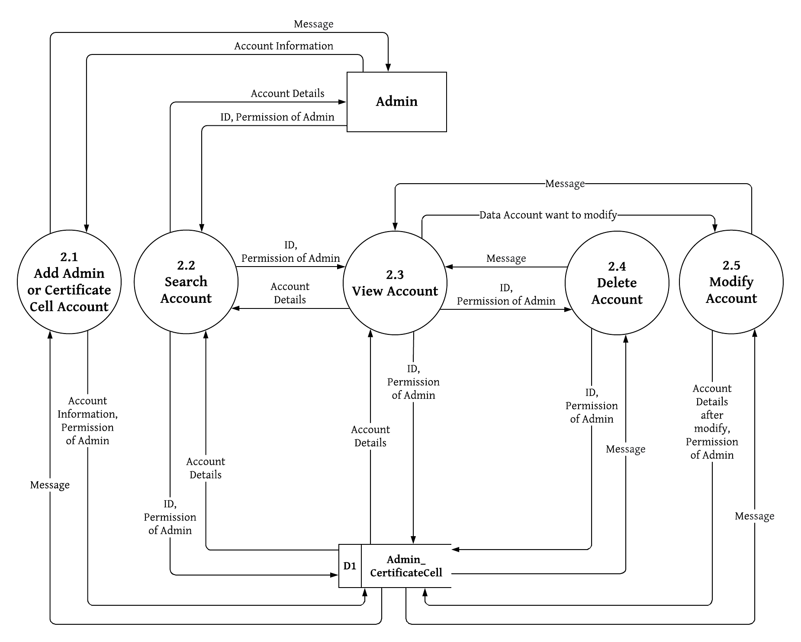
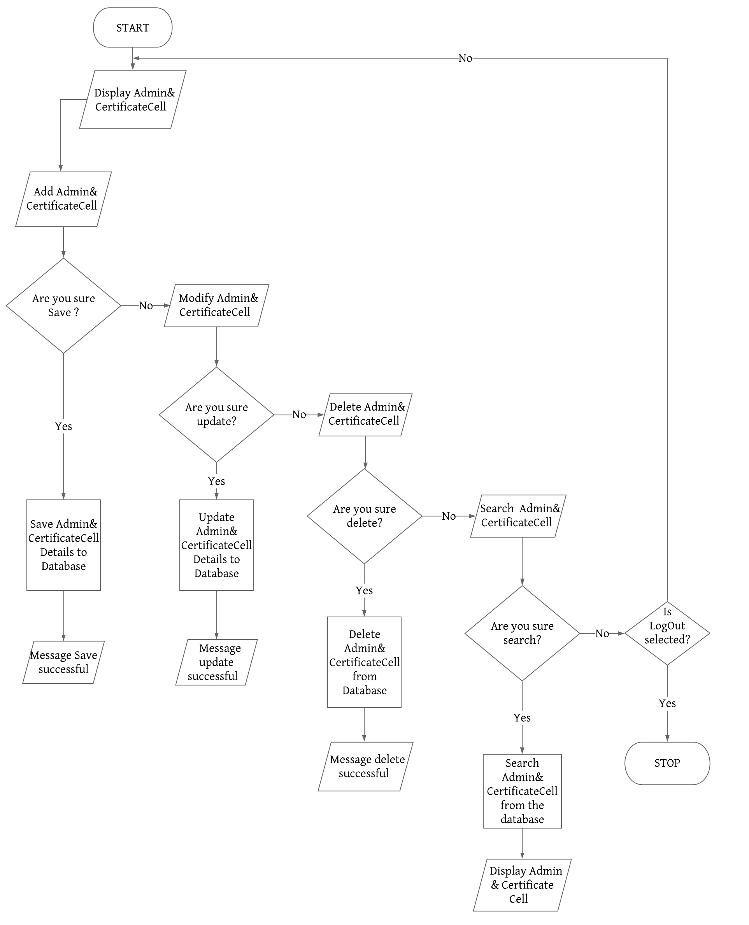
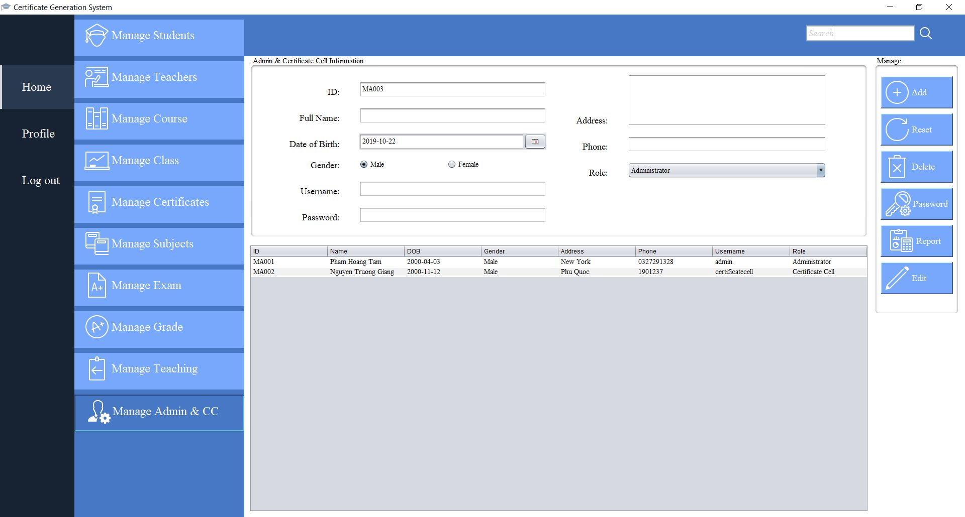

Slide 21

MANAGE
STUDENTS

Slide 22
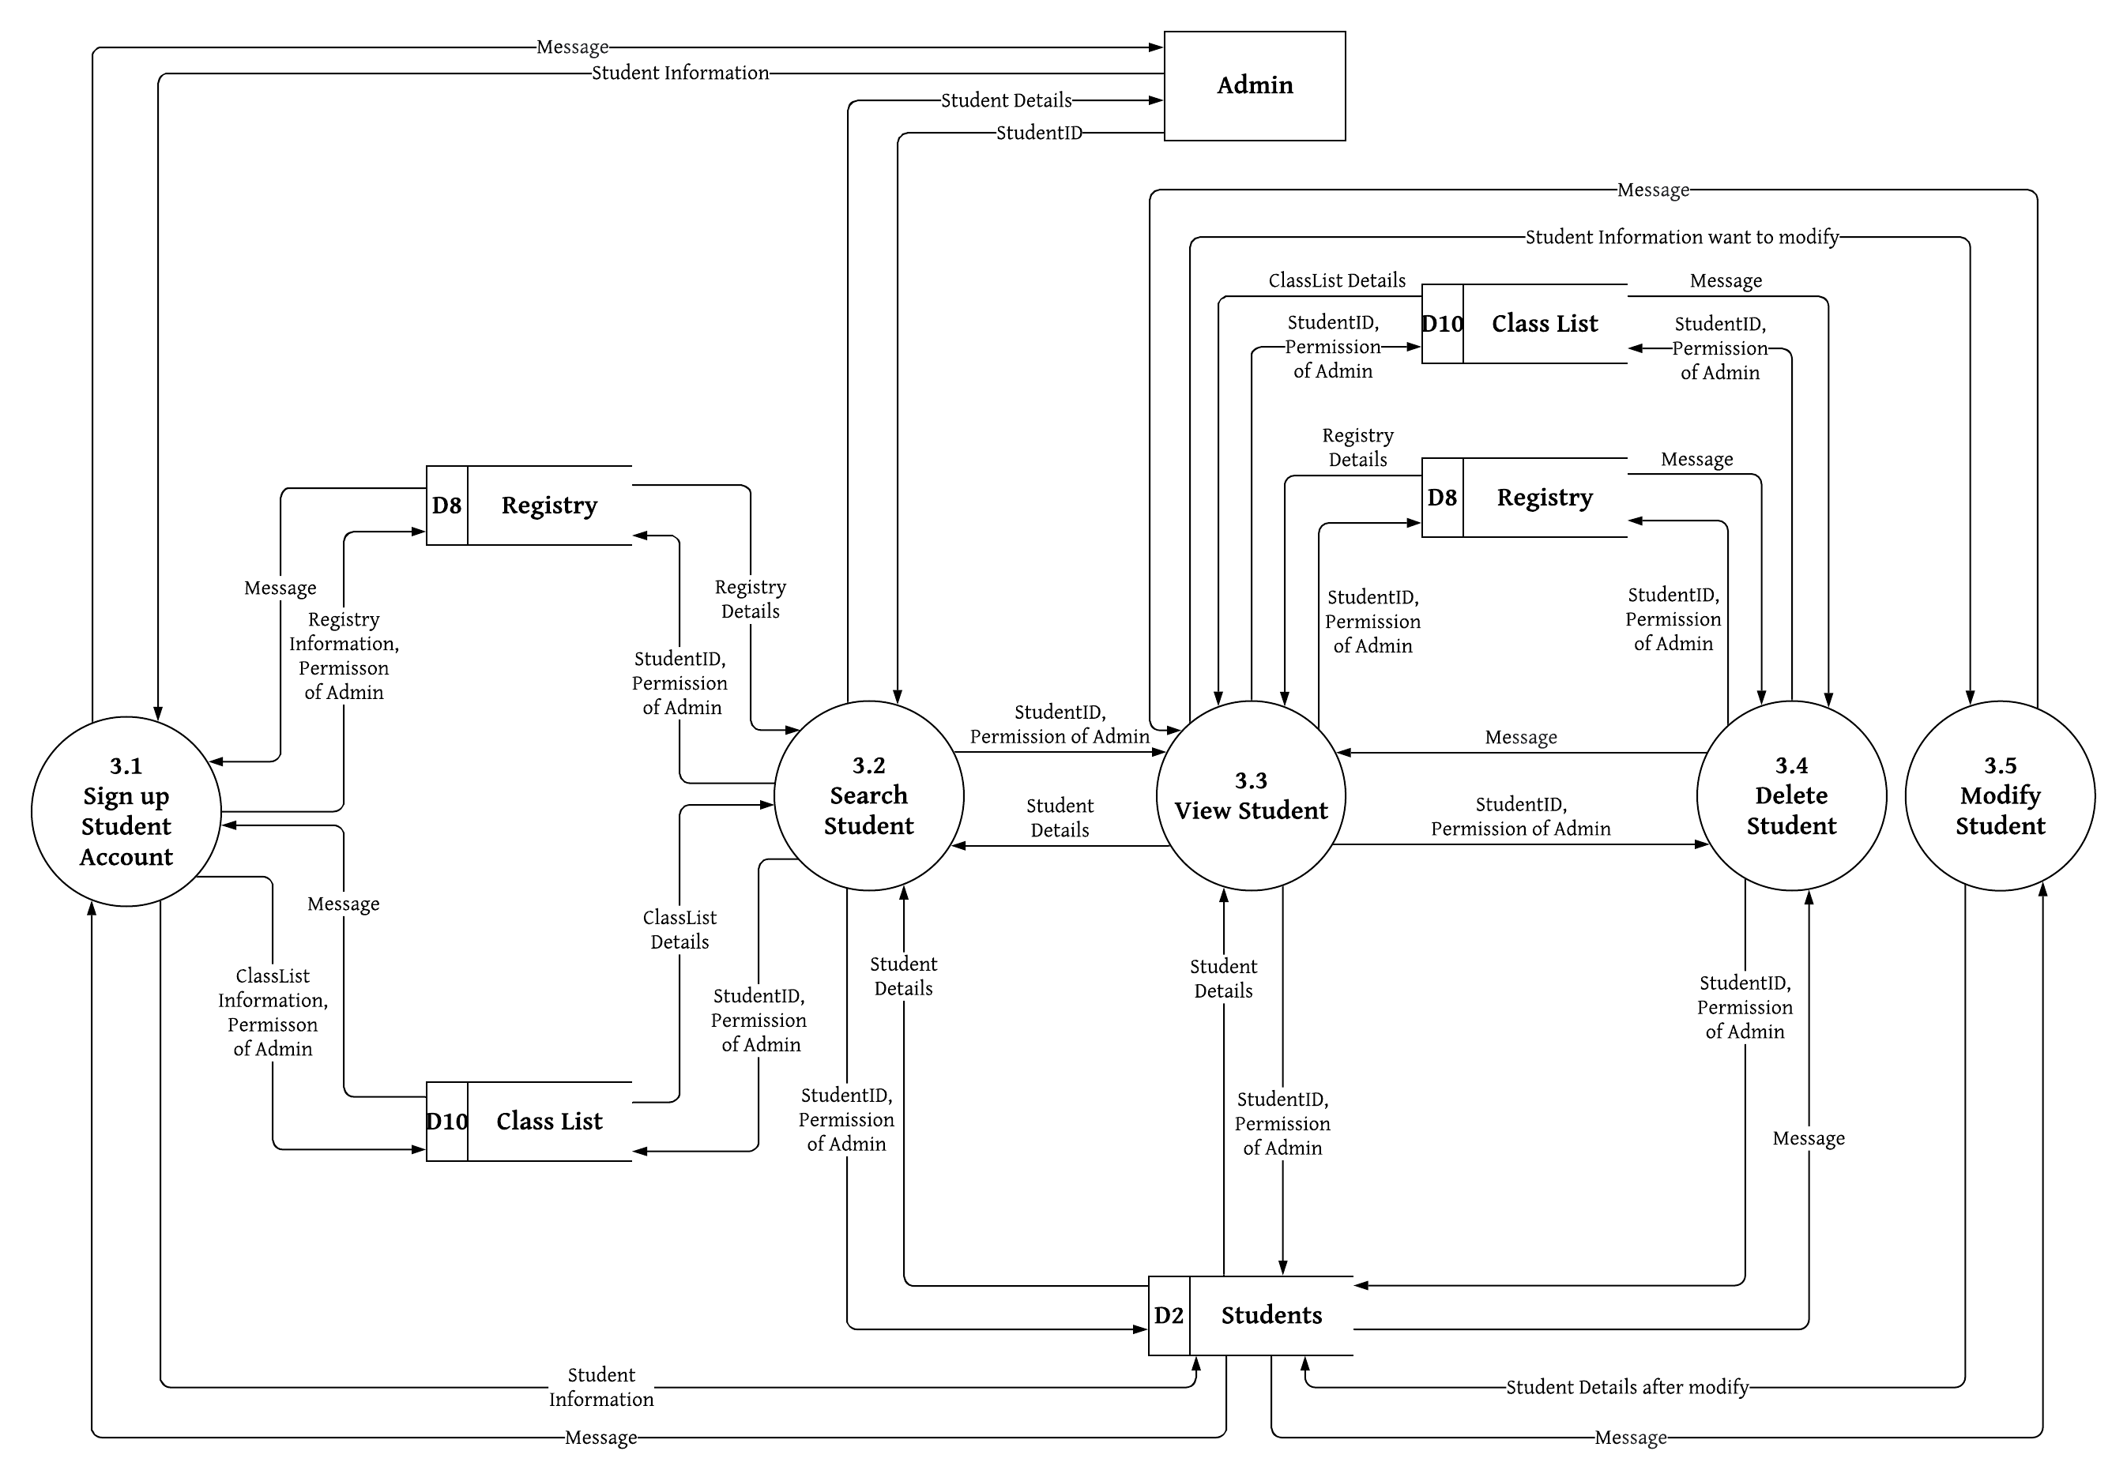
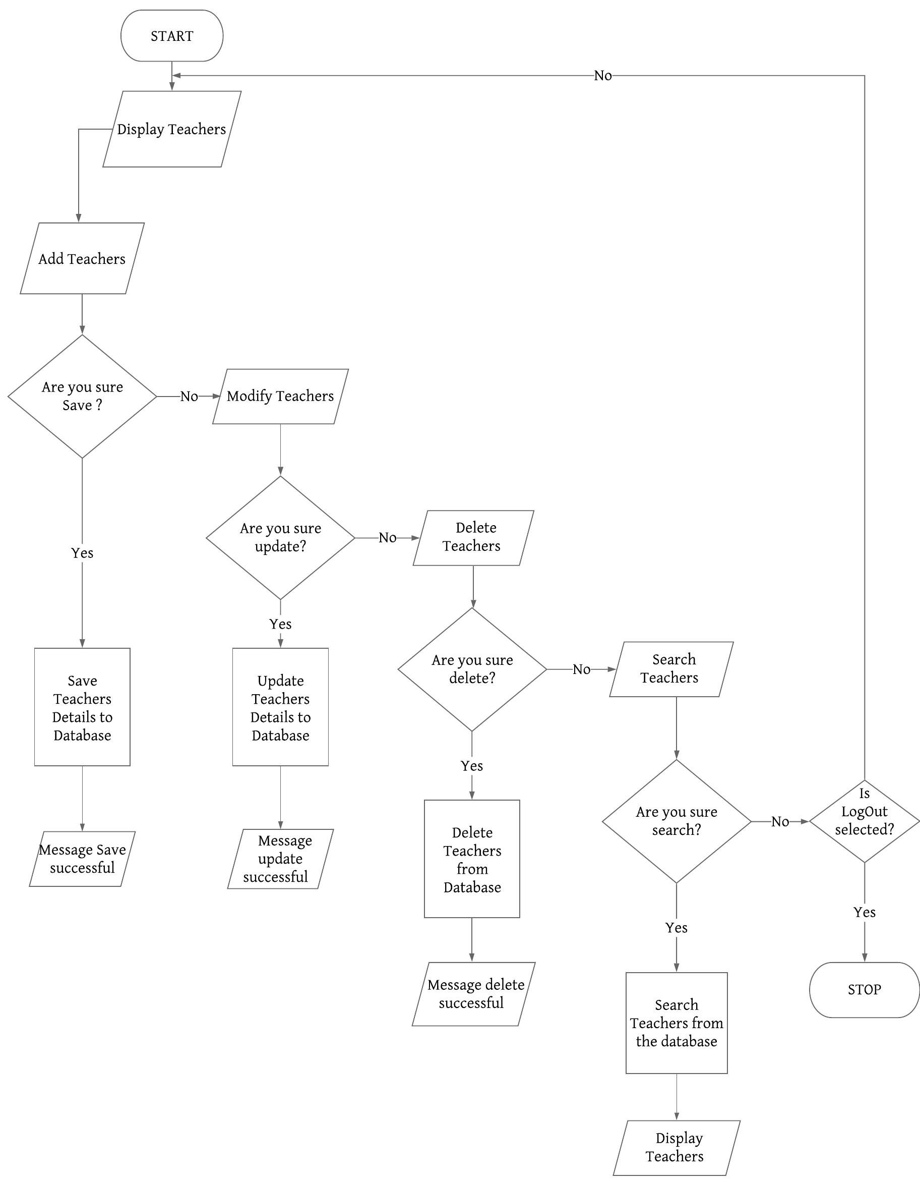
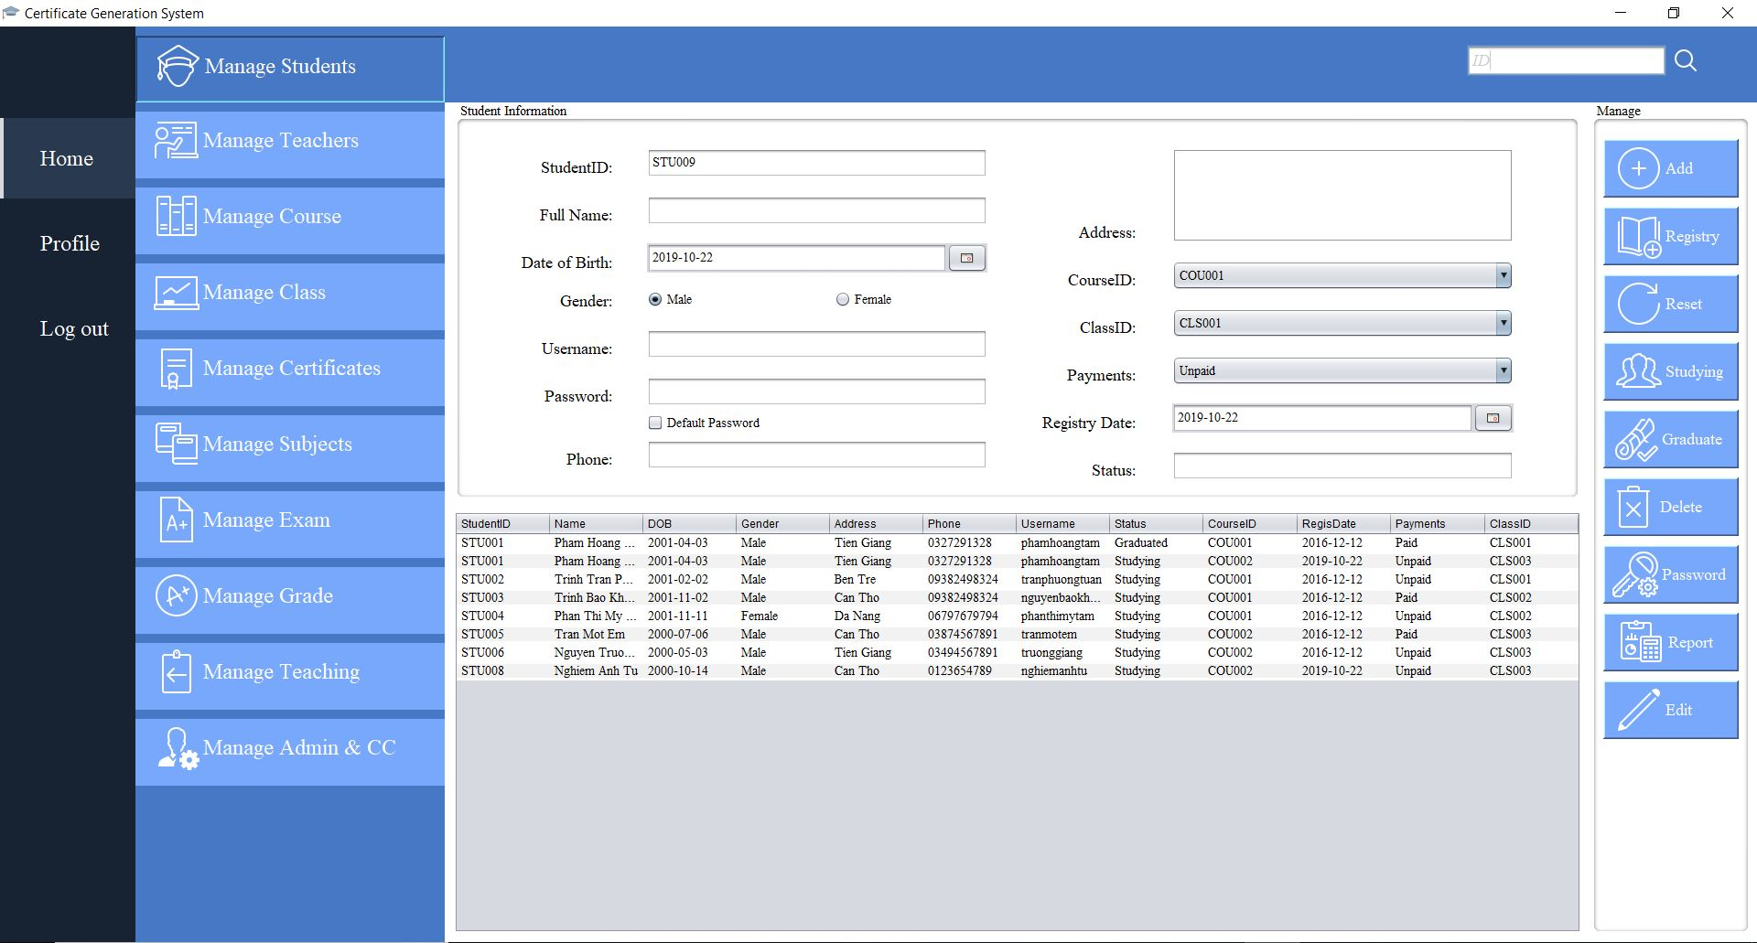

Slide 23

MANAGE
CERTIFICATE

Slide 24
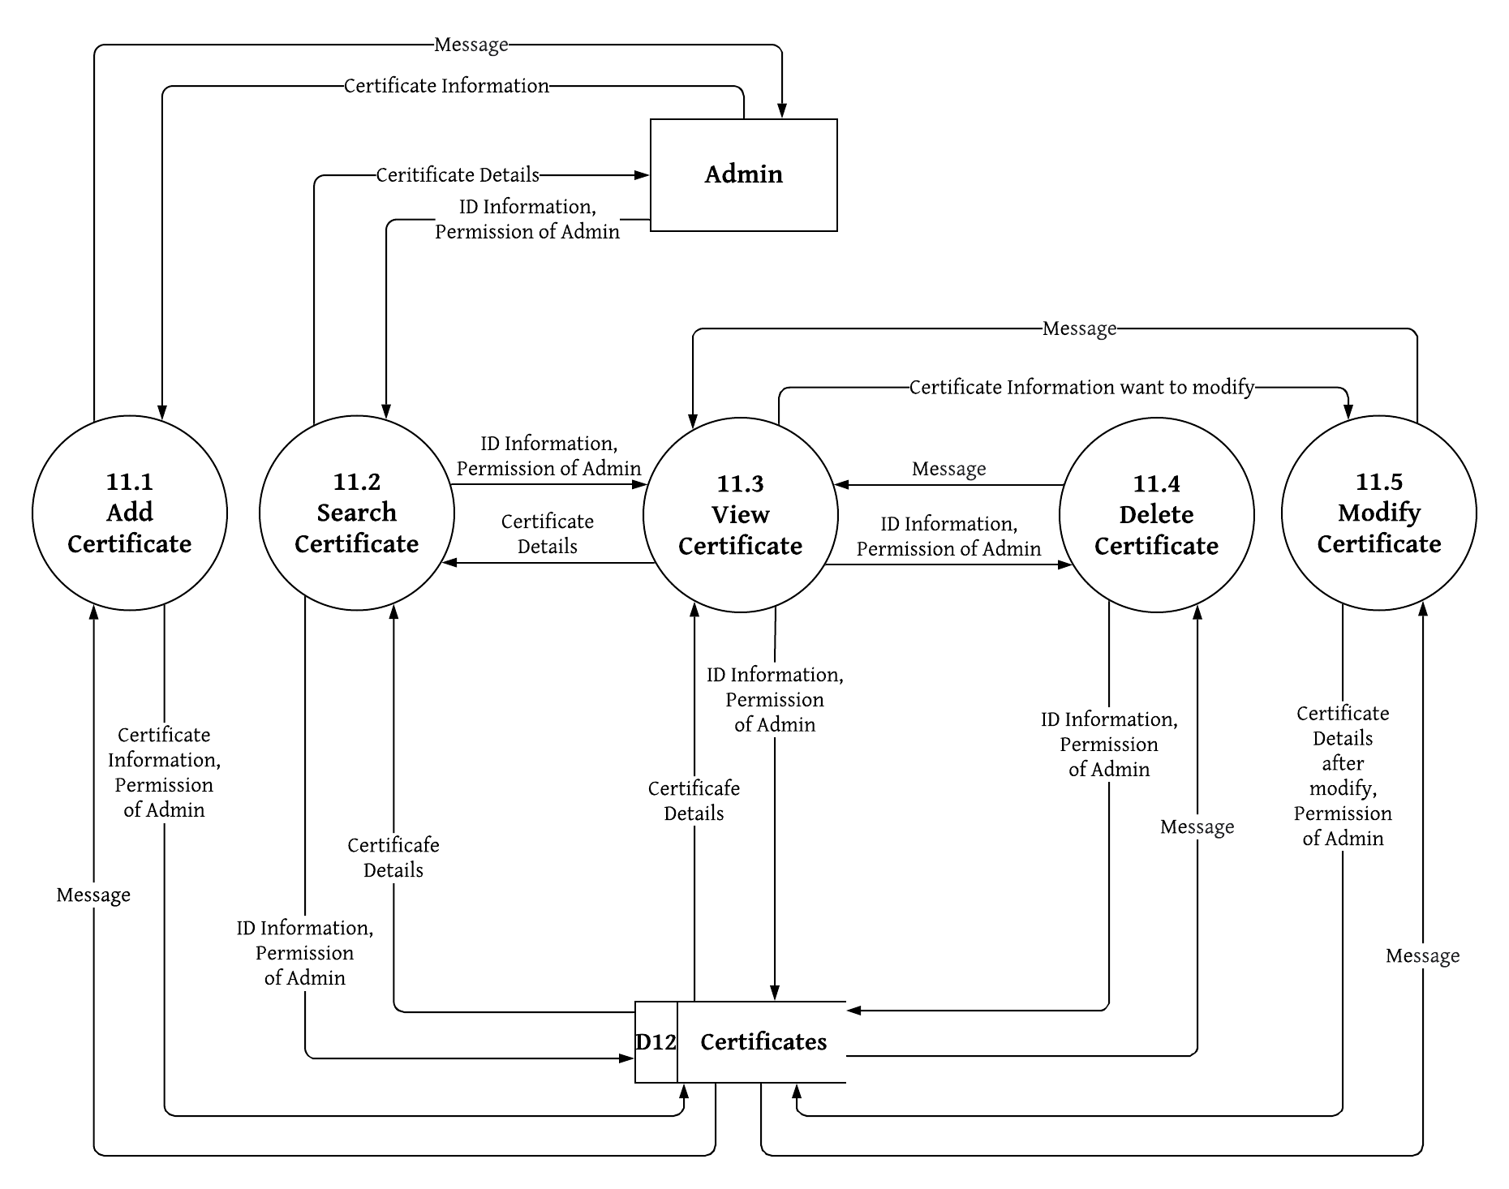
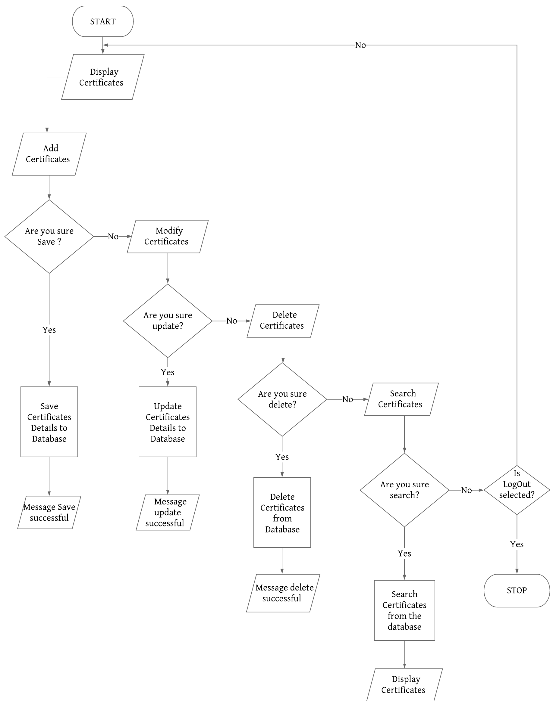
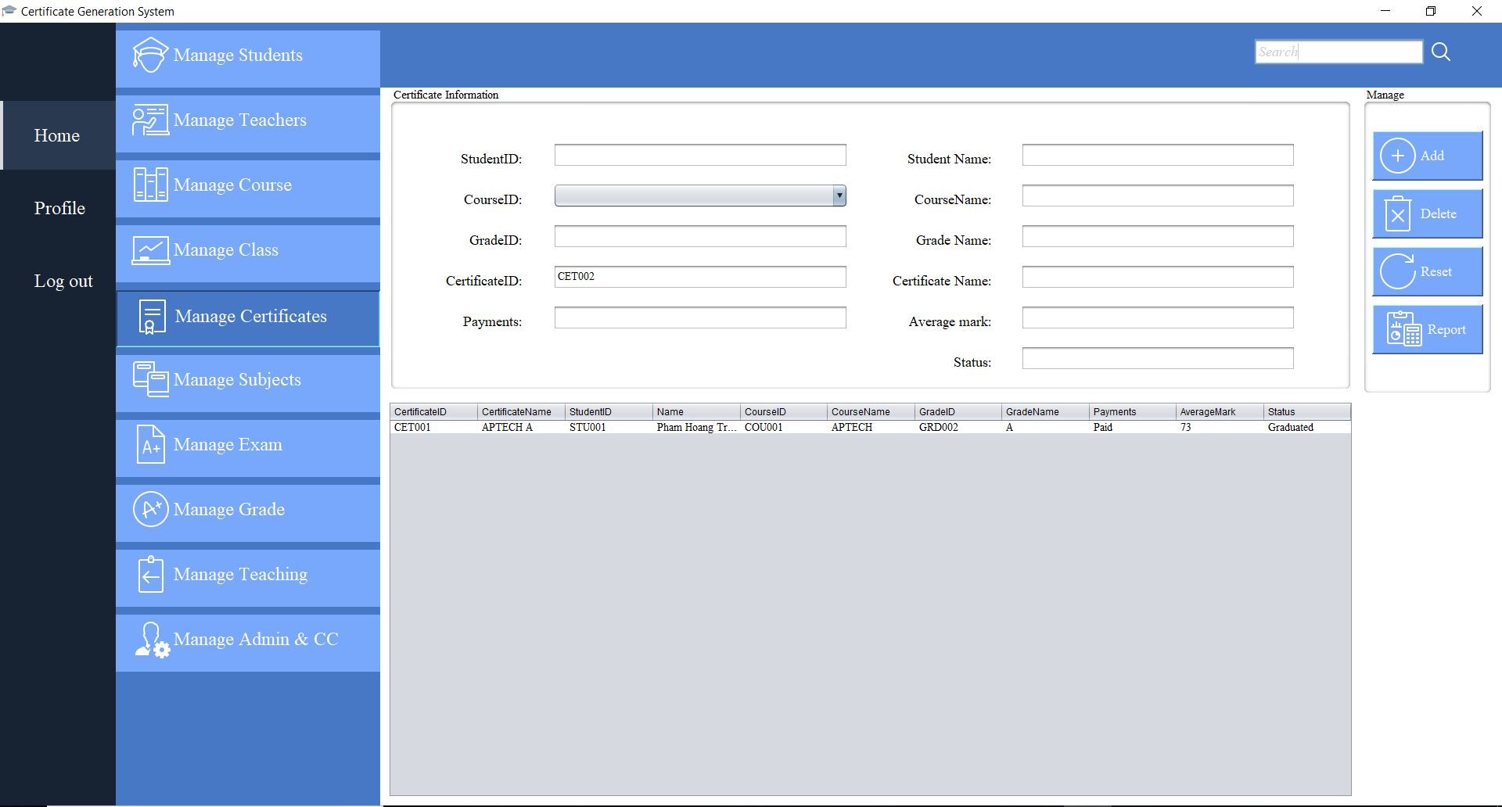

Slide 25

MANAGE
SEARCH AND VERIFY STUDENT PROFILE

Slide 26
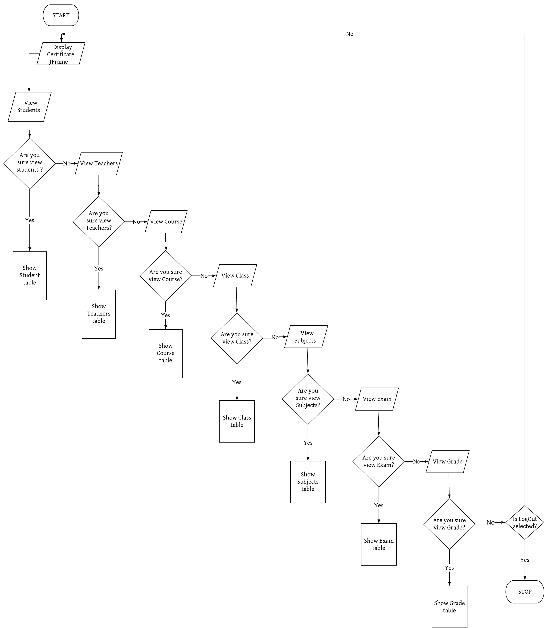
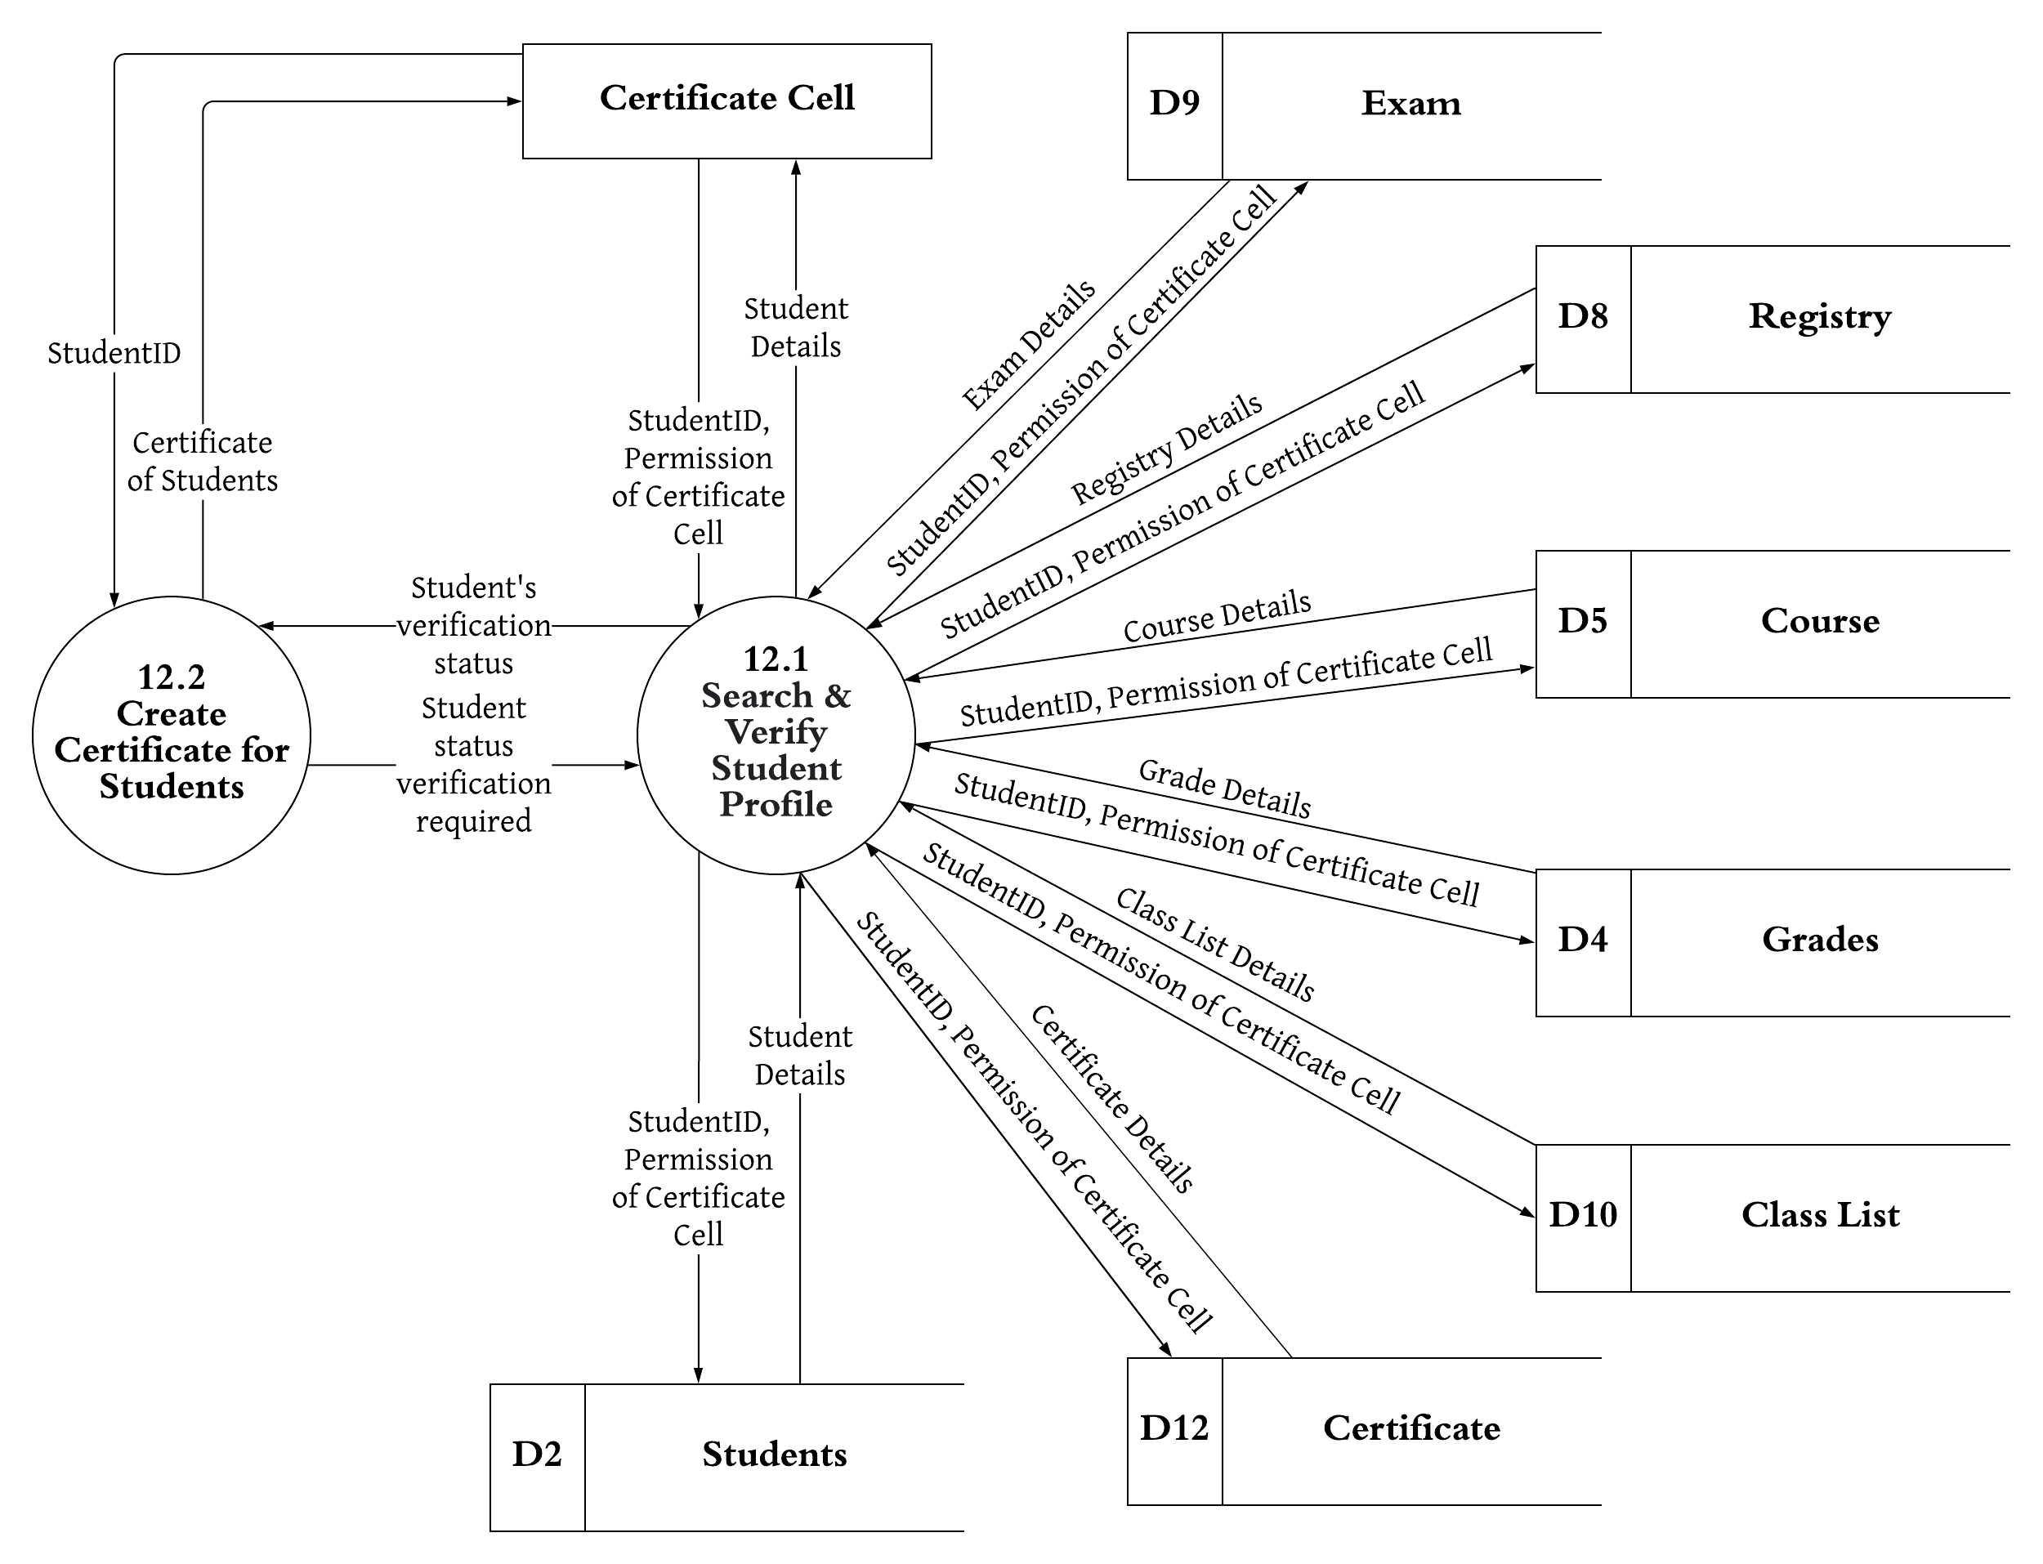
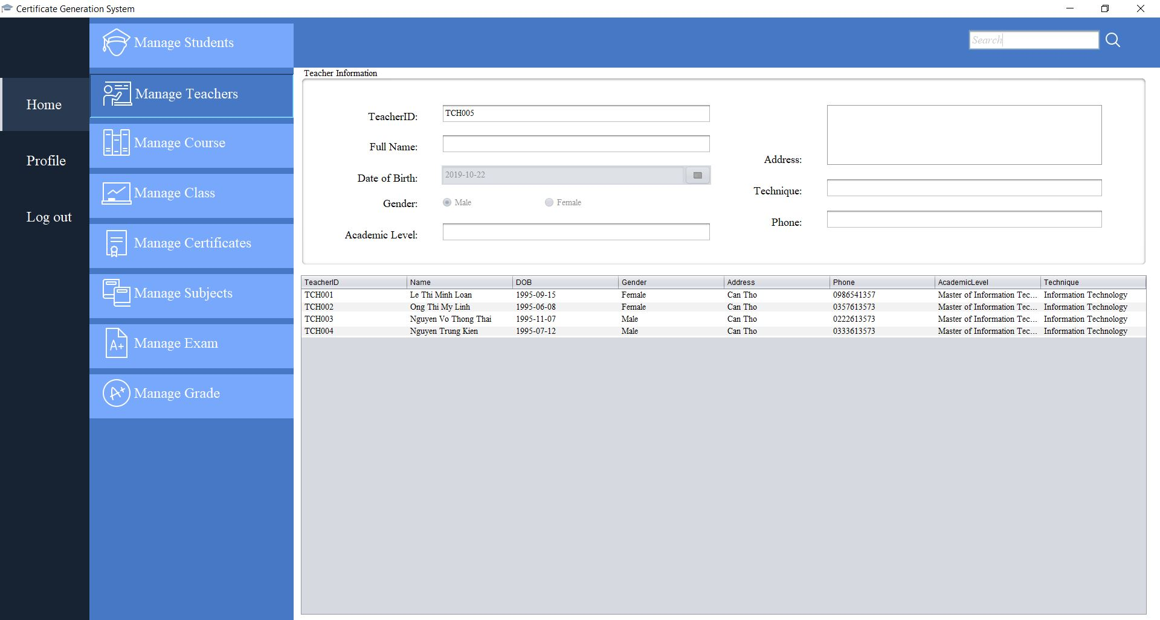

Slide 27

MANAGE
IUUSED CERTIFICATE

Slide 28
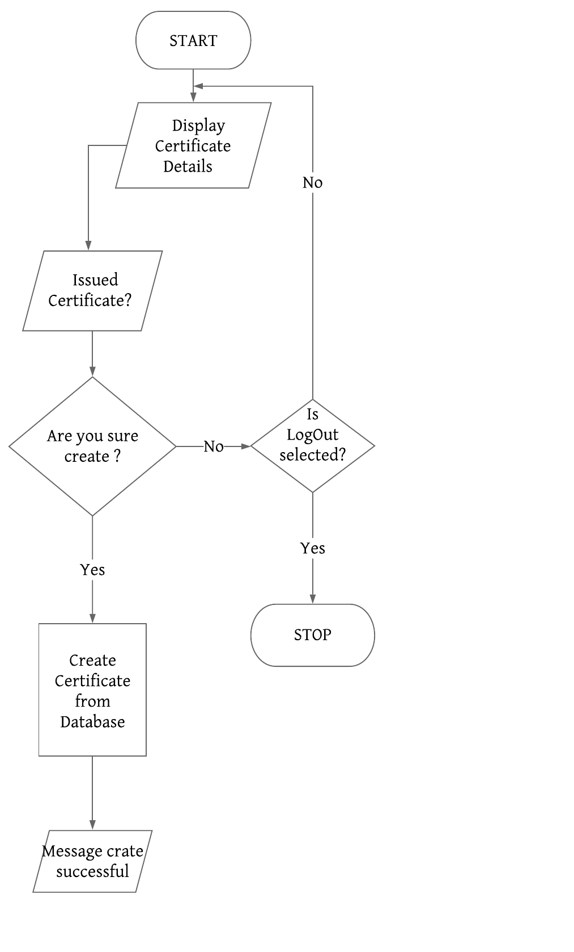

Slide 29

CREATE
REPORT

Slide 31
CREATE
COURSE

Slide 32
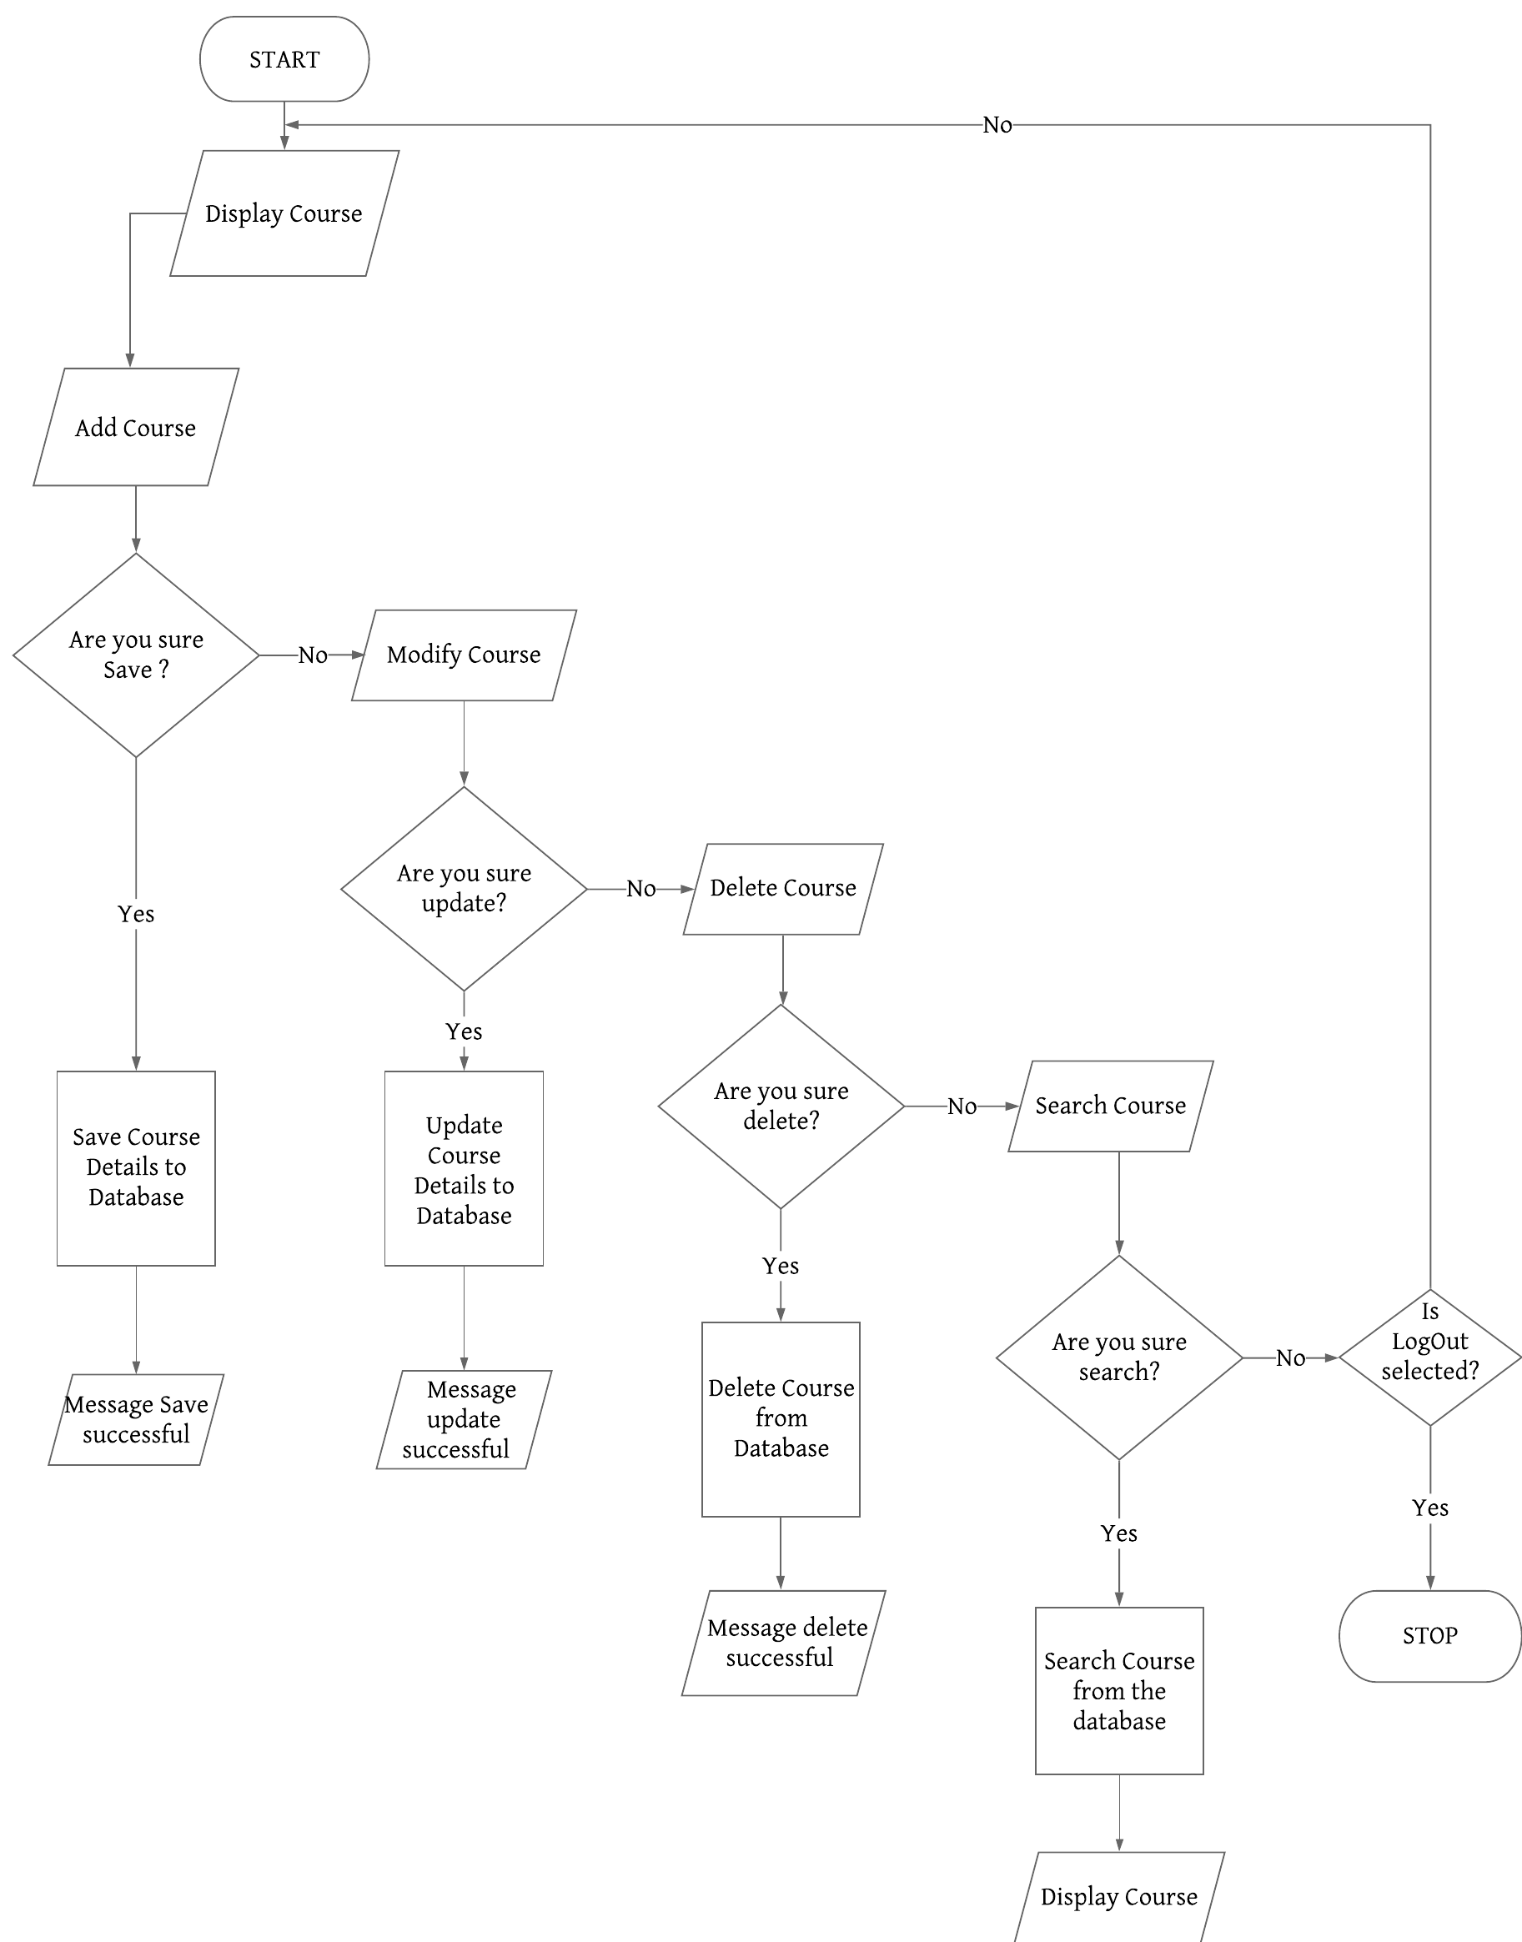
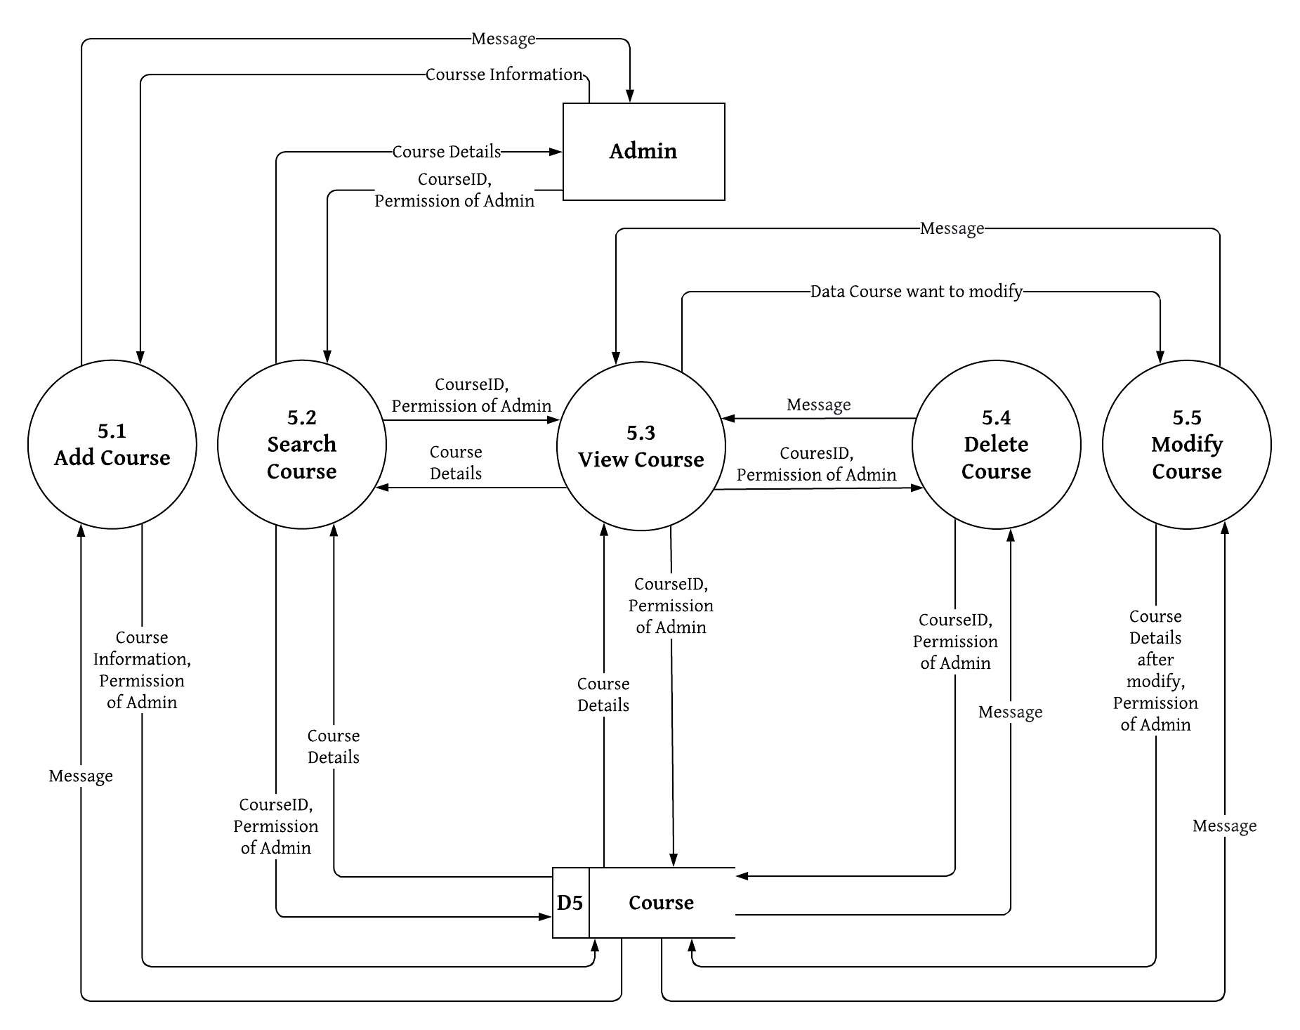
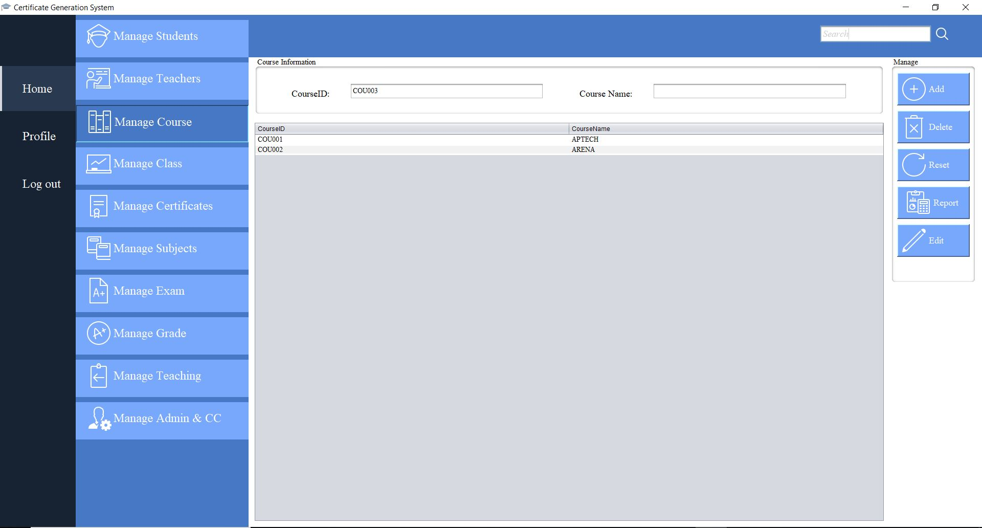

Slide 33

CREATE
EXAM

Slide 34
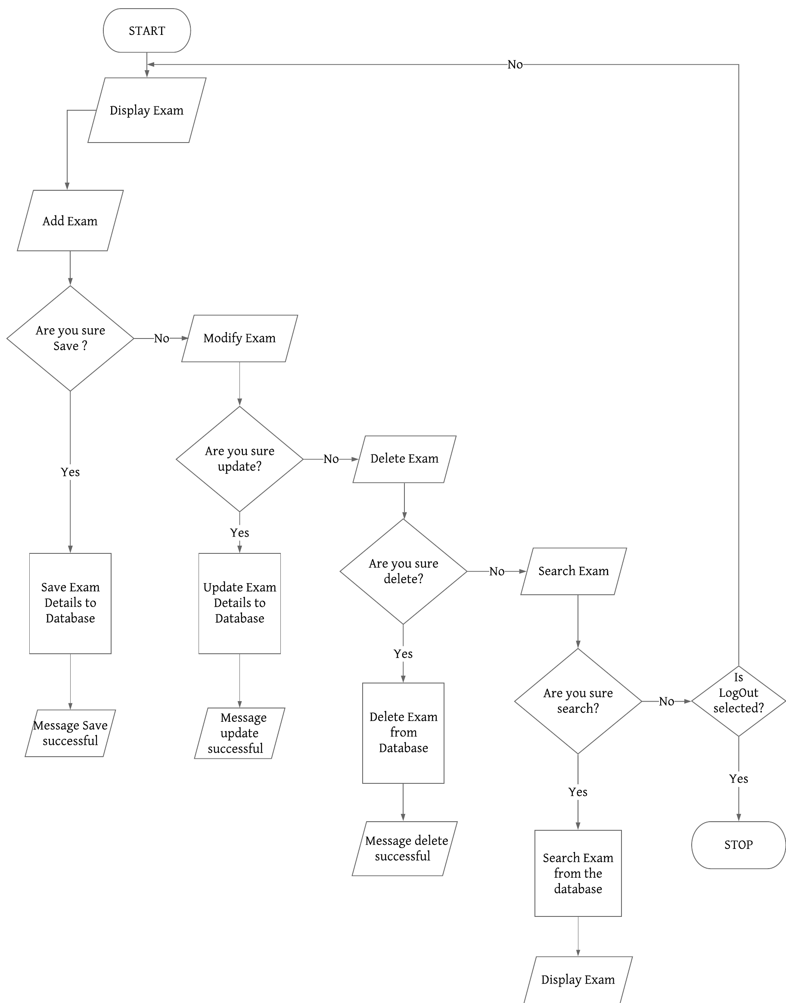
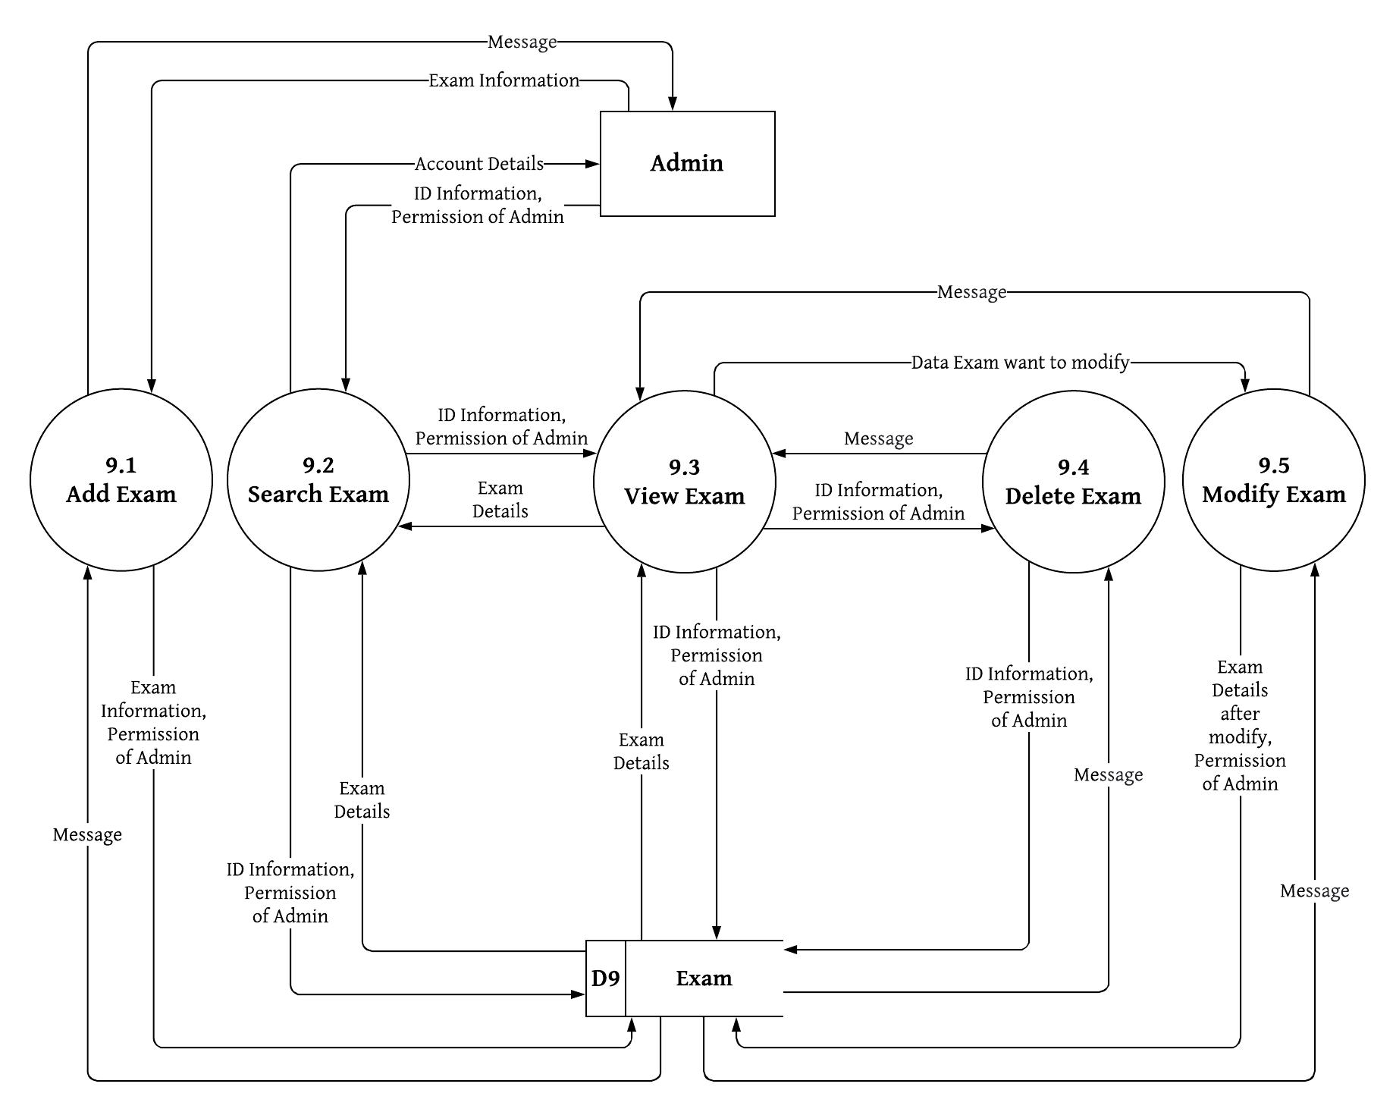
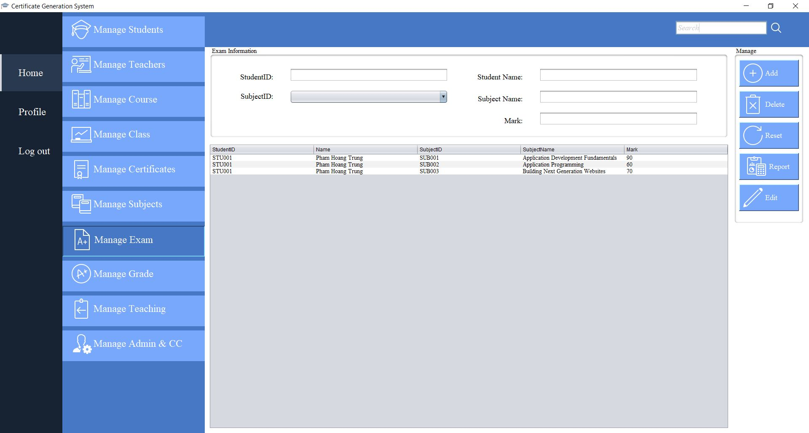

Slide 35

CREATE
SUBJECTS

Slide 36
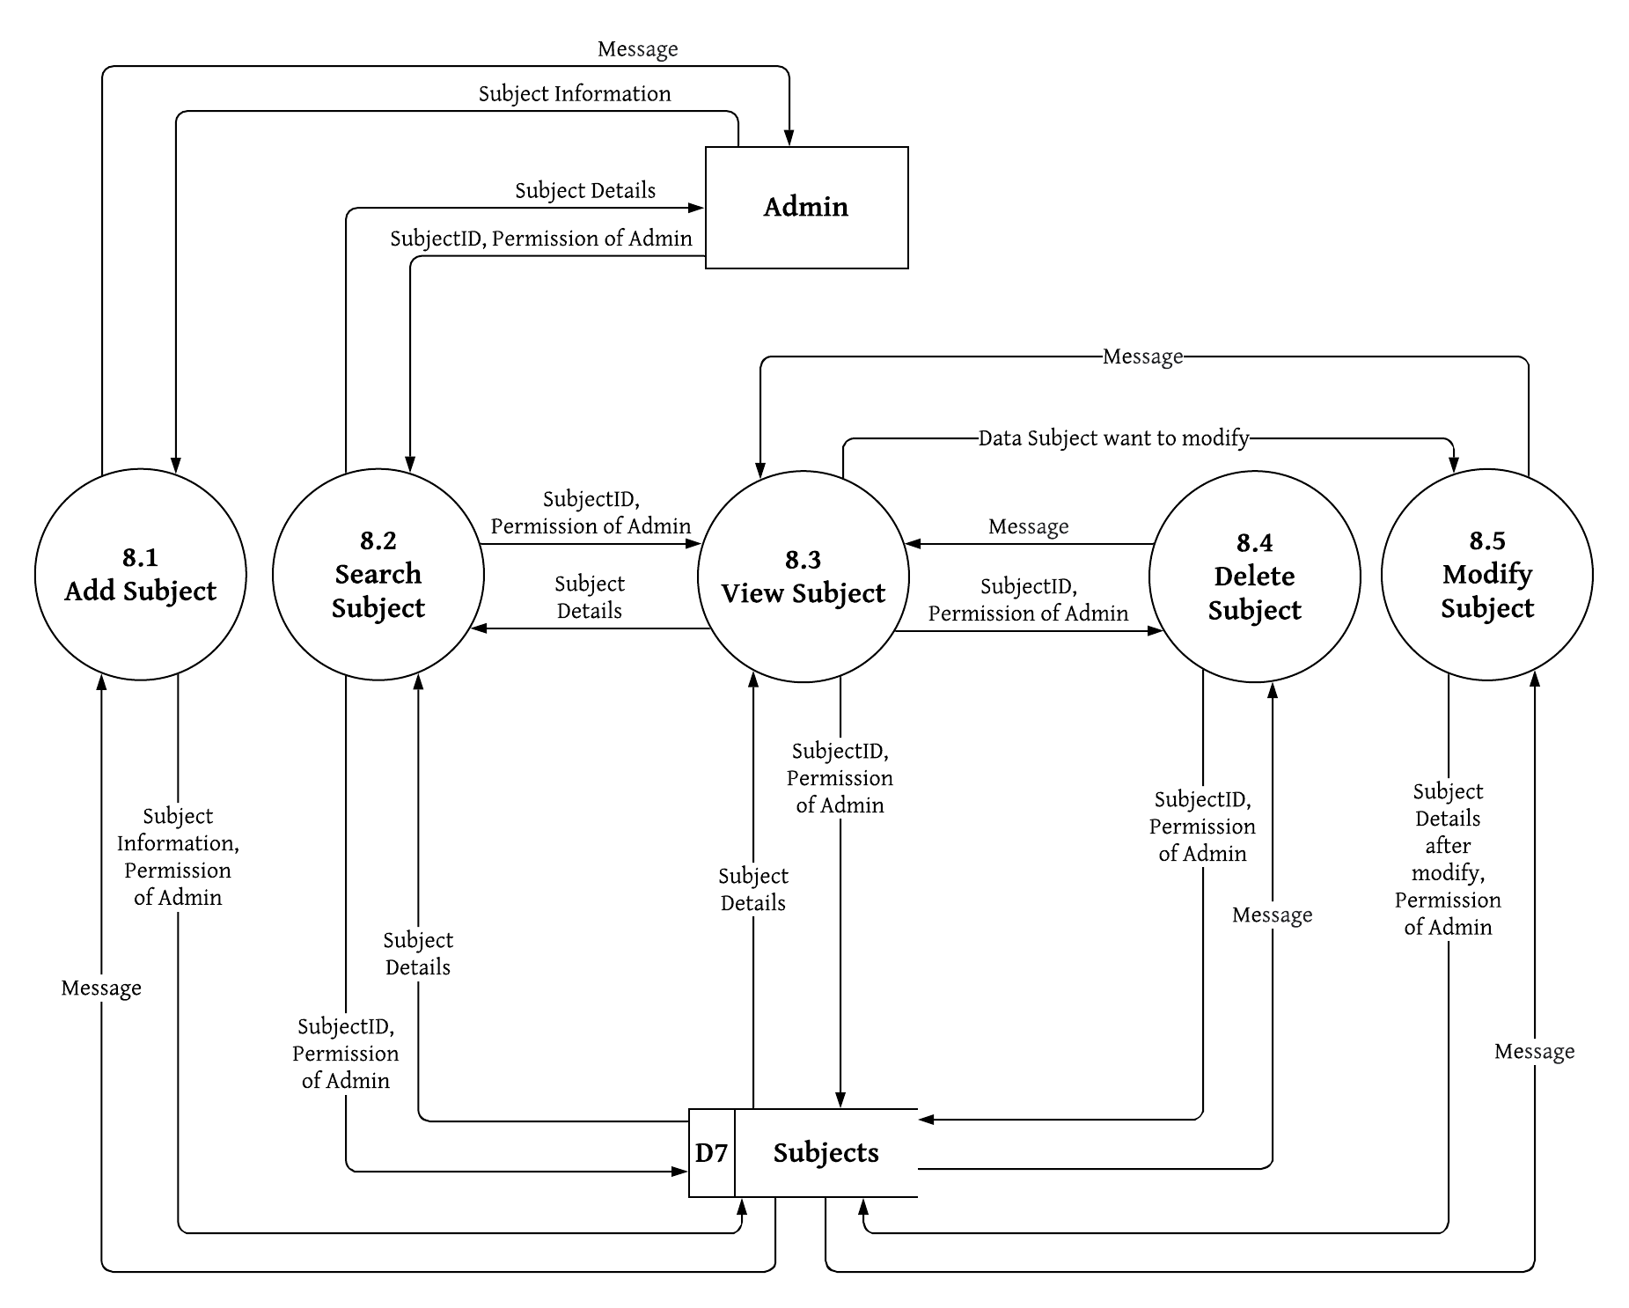

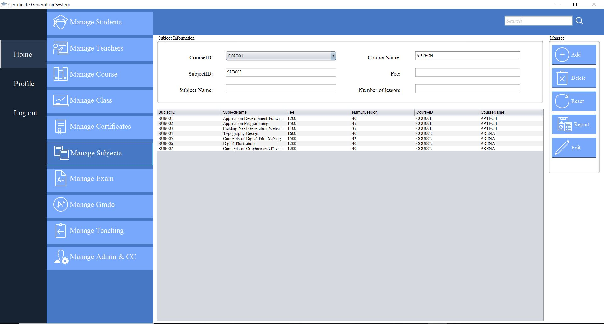

Slide 37
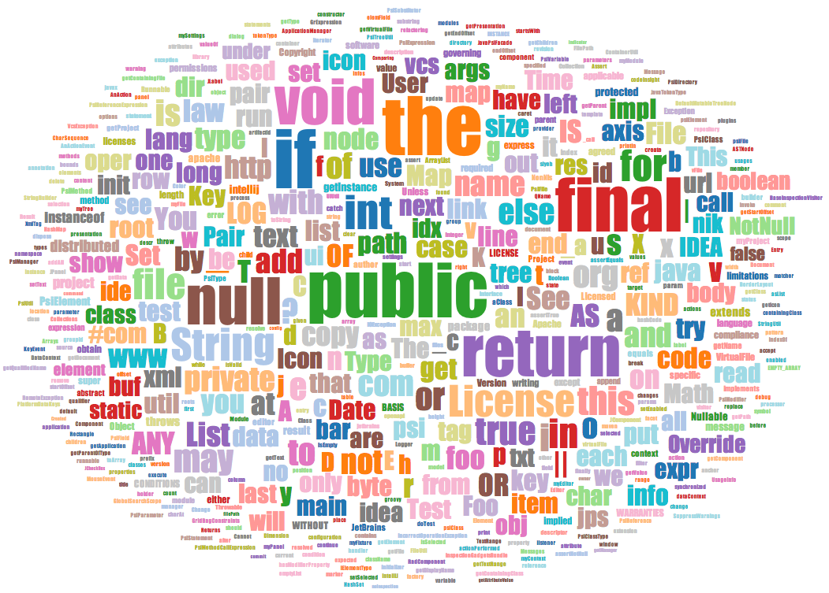
CREATE
GRADE

Slide 38

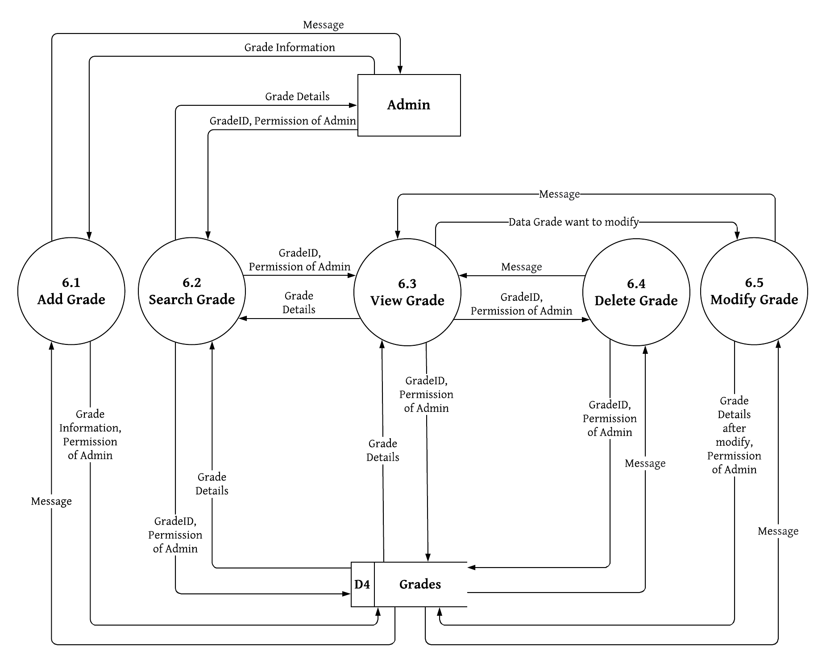
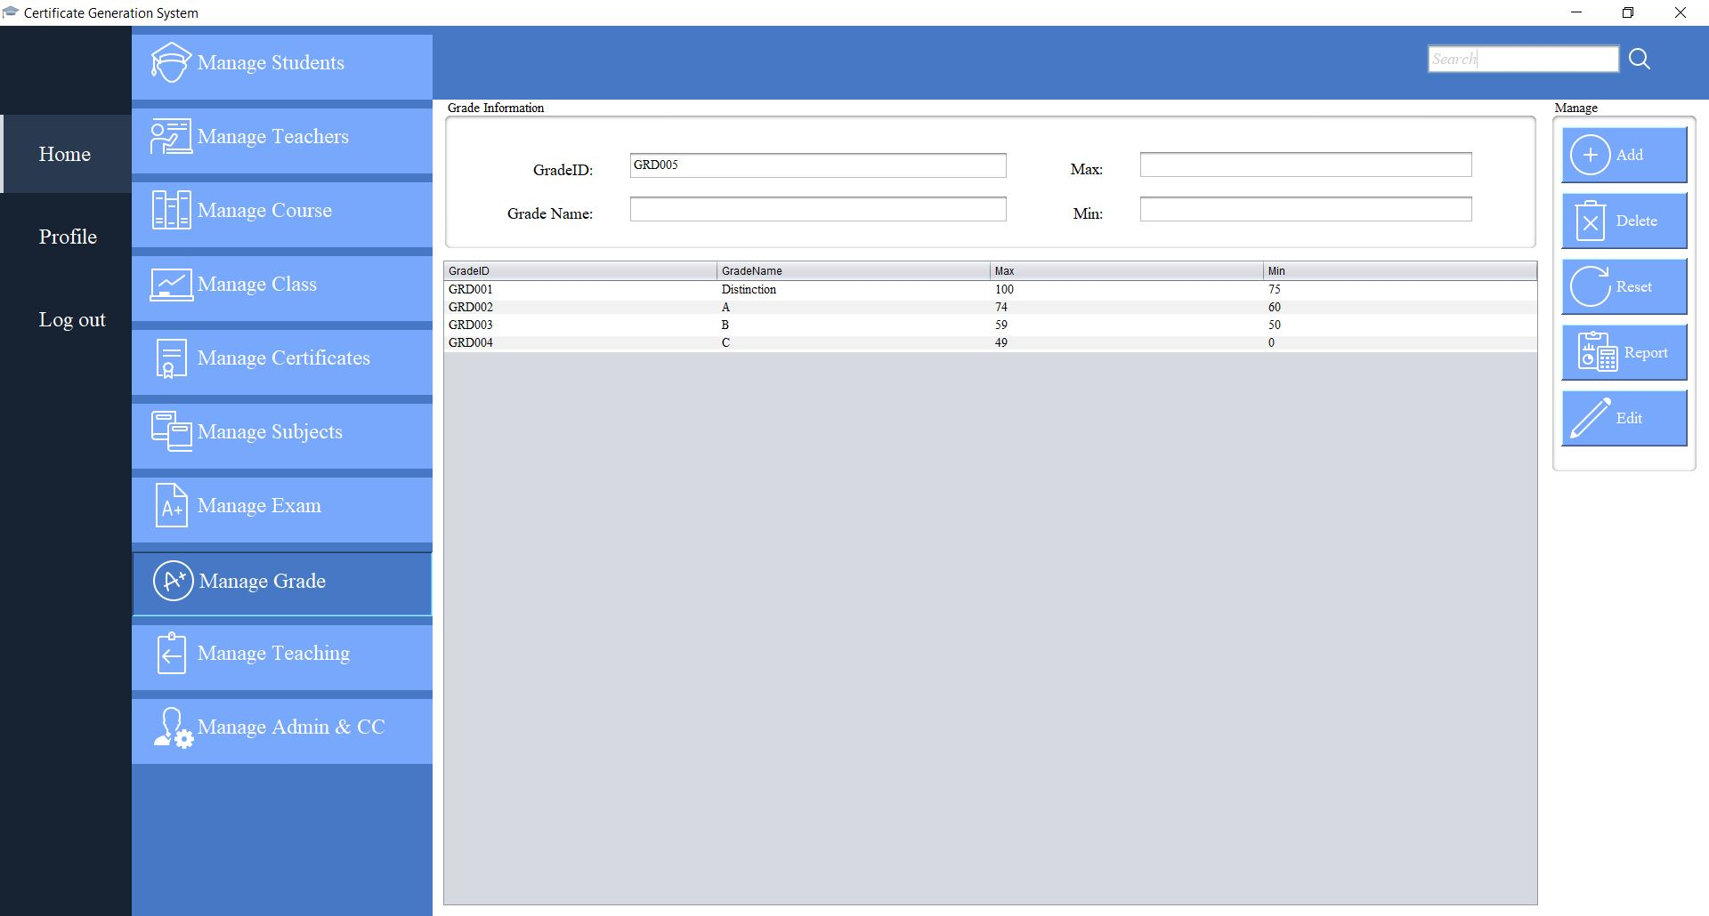

Slide 39

CREATE
TEACHERS

Slide 40

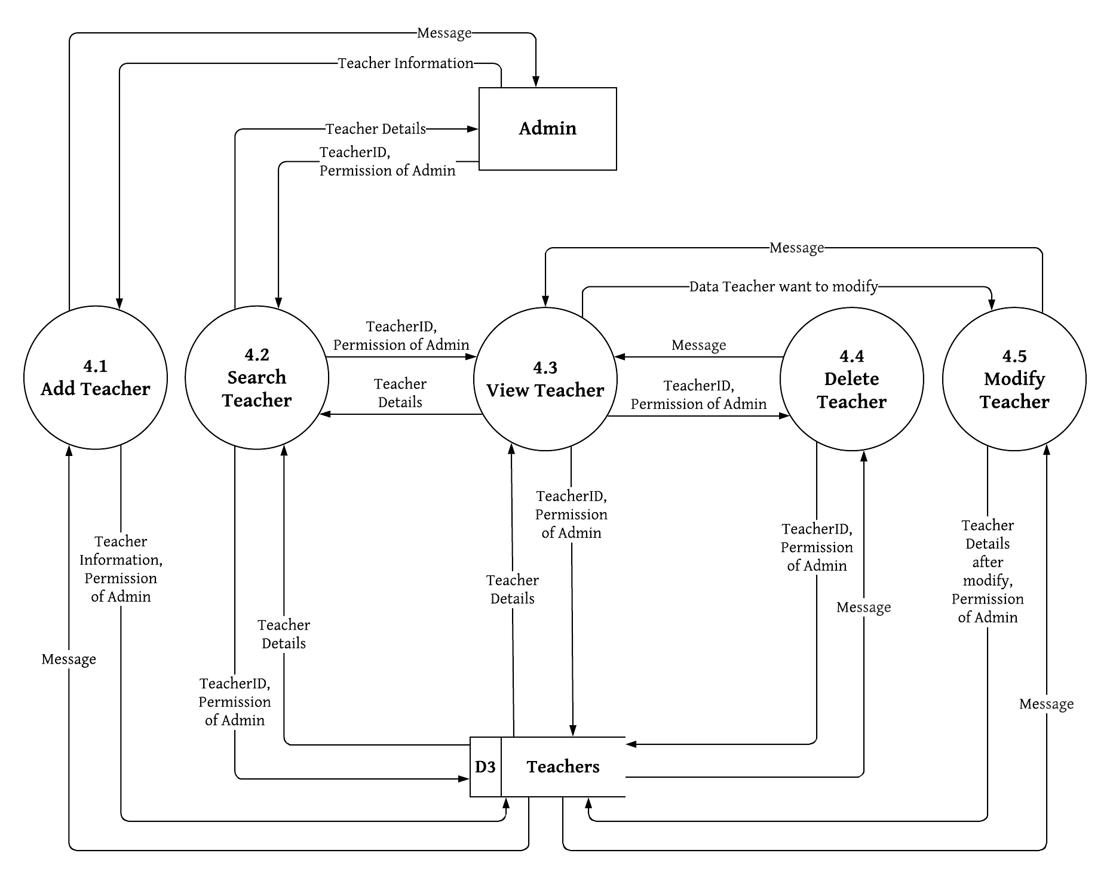
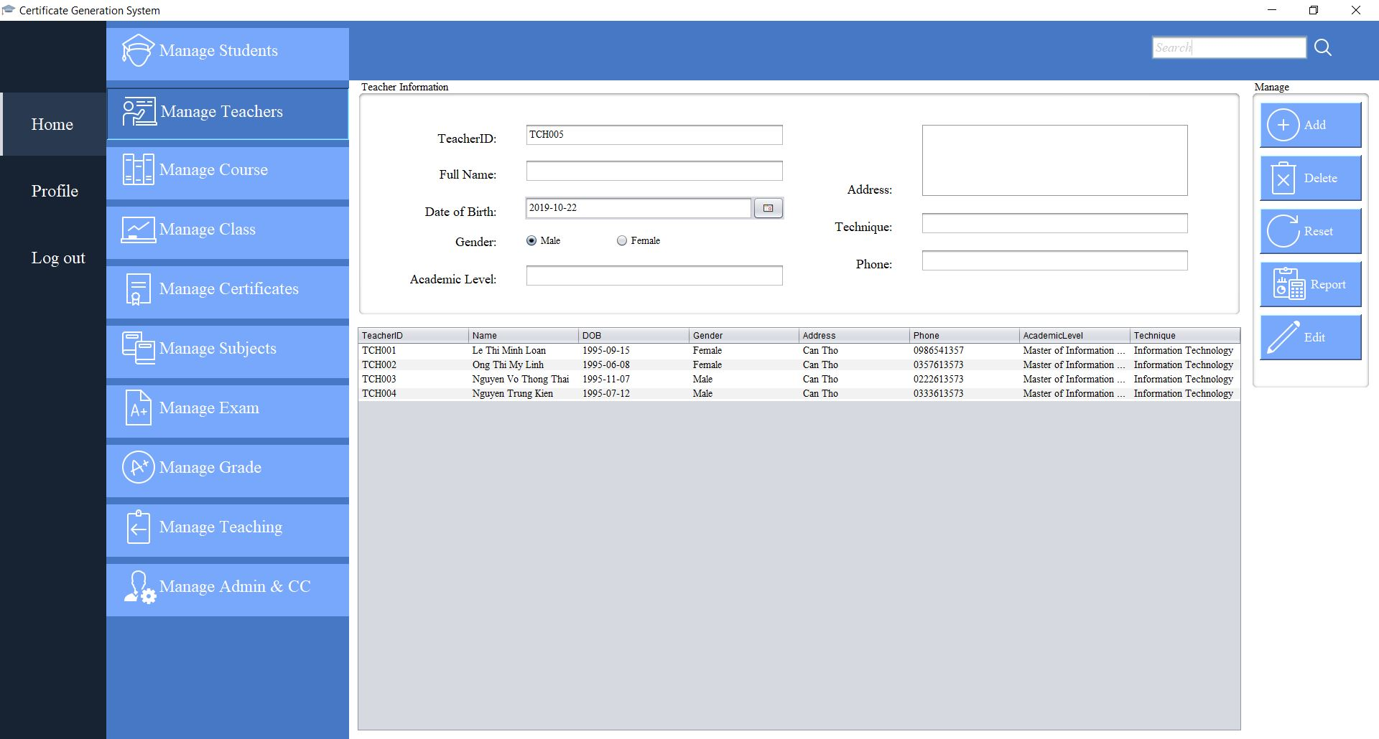

Slide 41
CREATE
CLASS

Slide 42


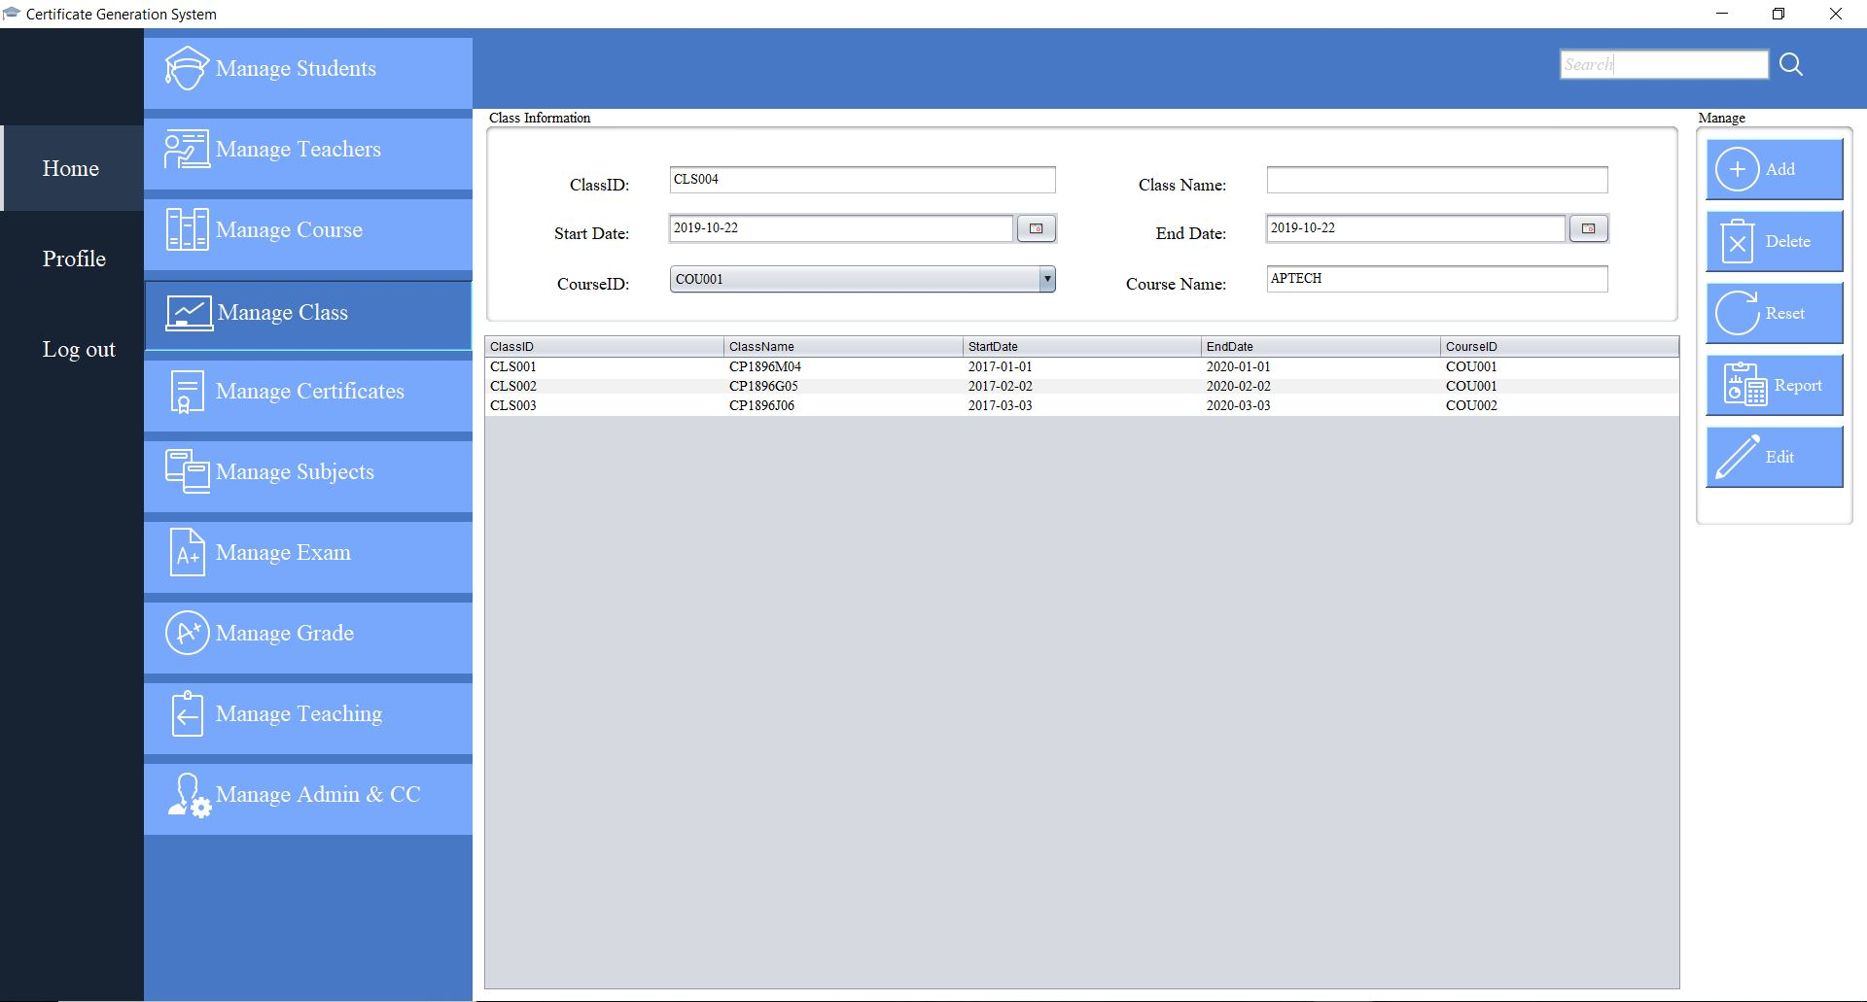

Slide 43
CREATE
TEACHING

Slide 44


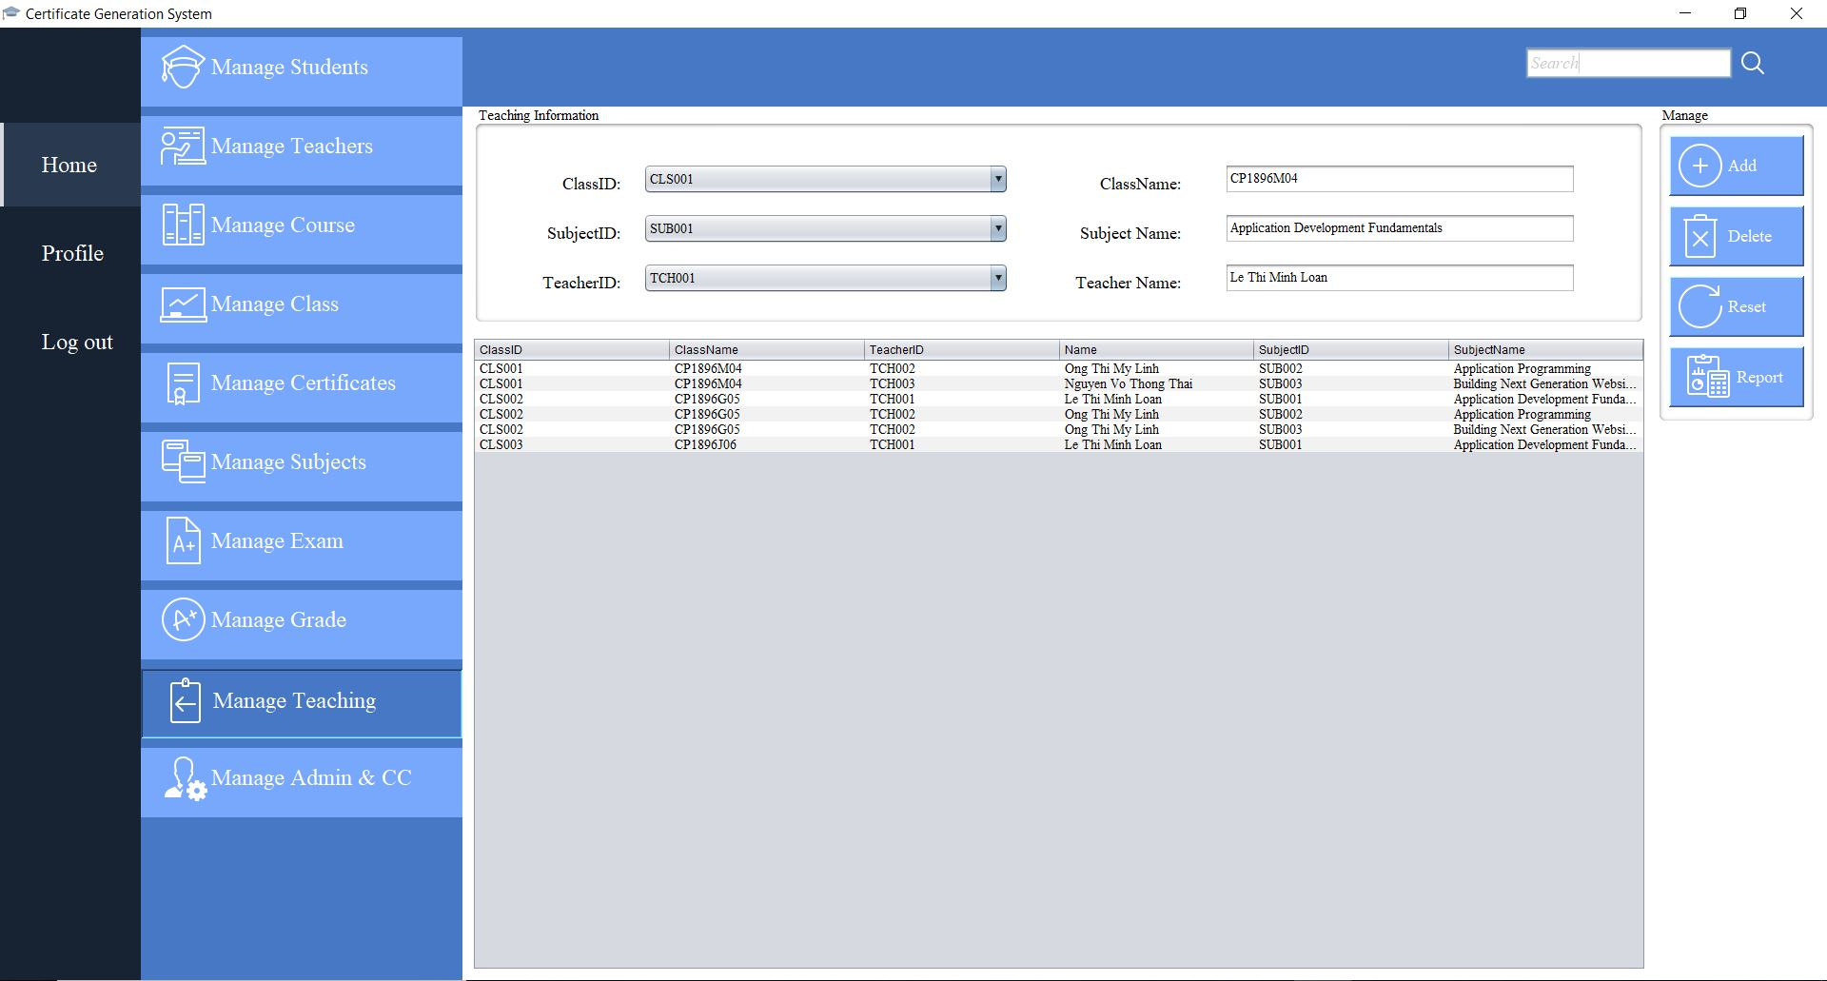

Slide 45

CREATE
PERSONAL ACCOUNT

Slide 46
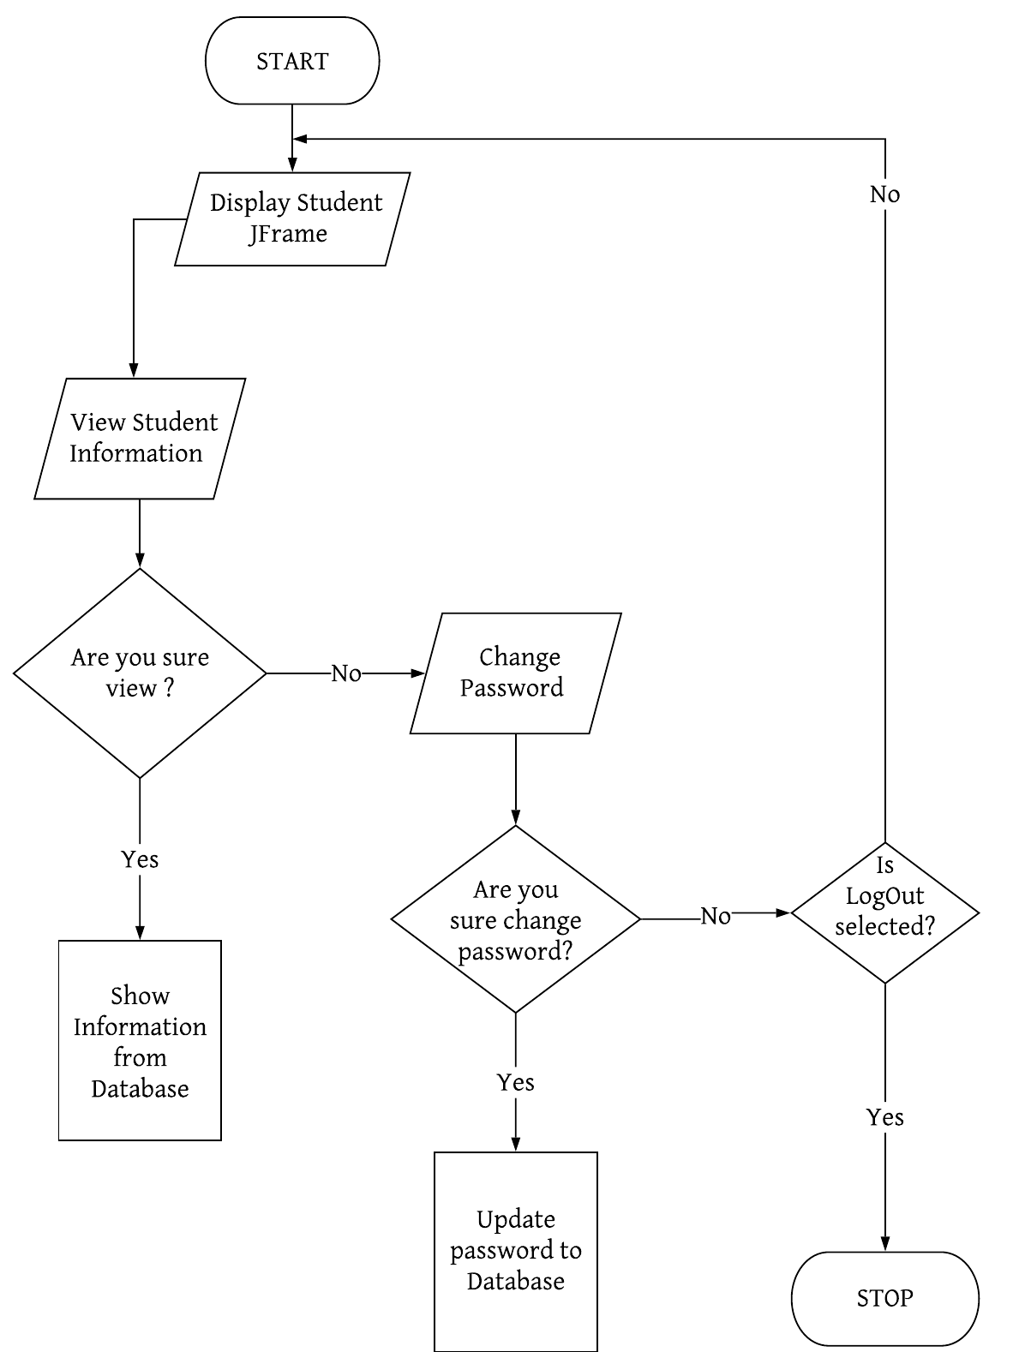
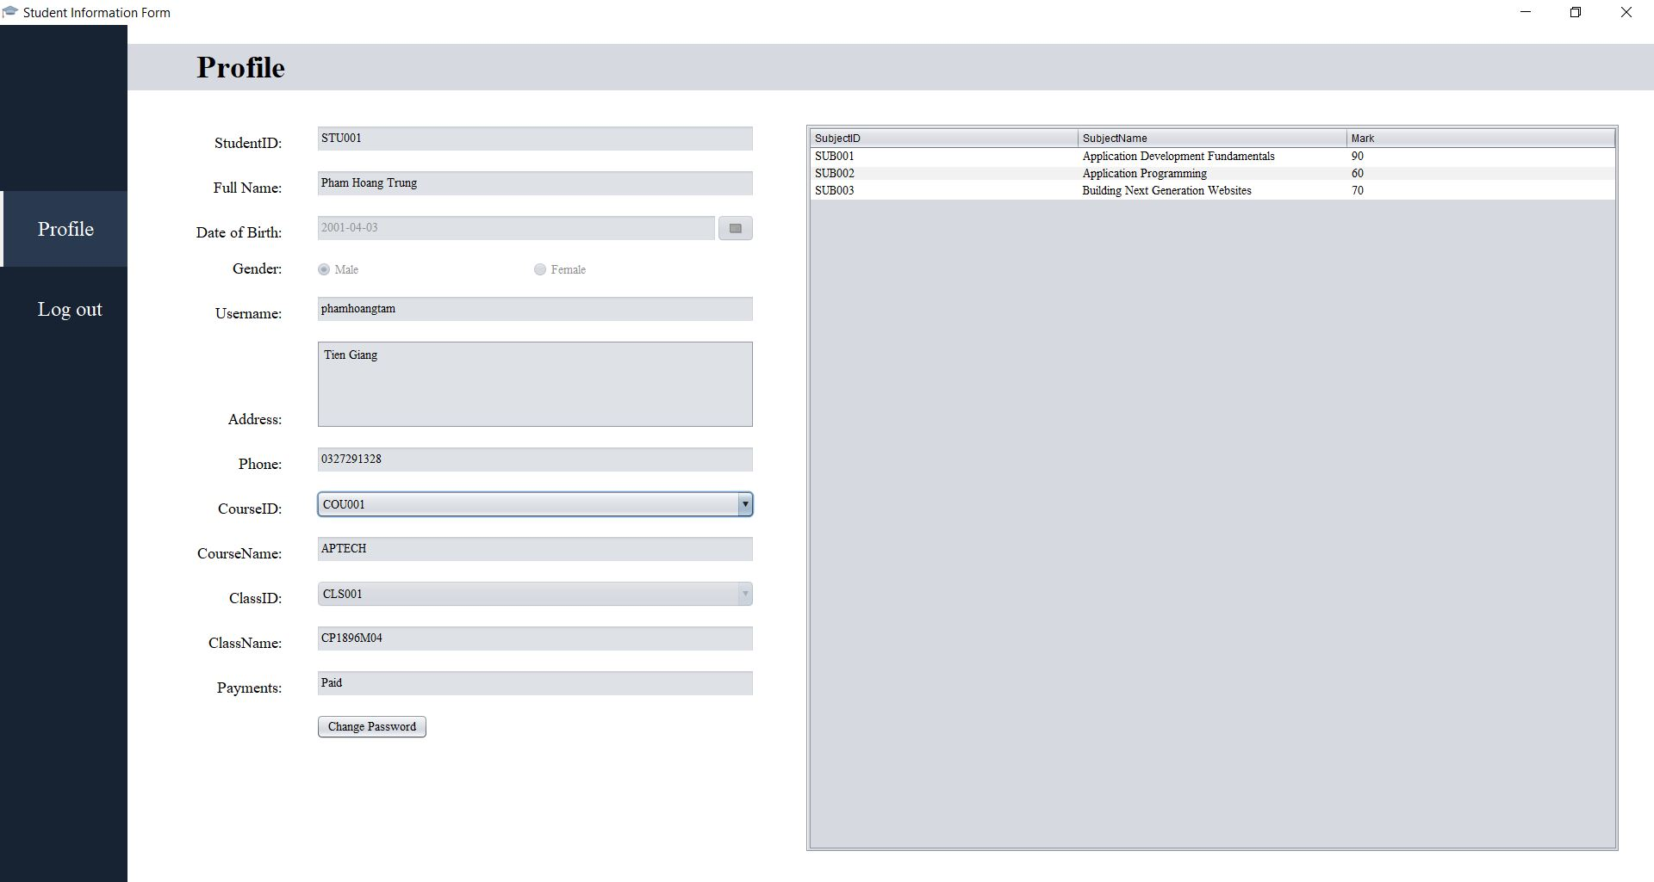
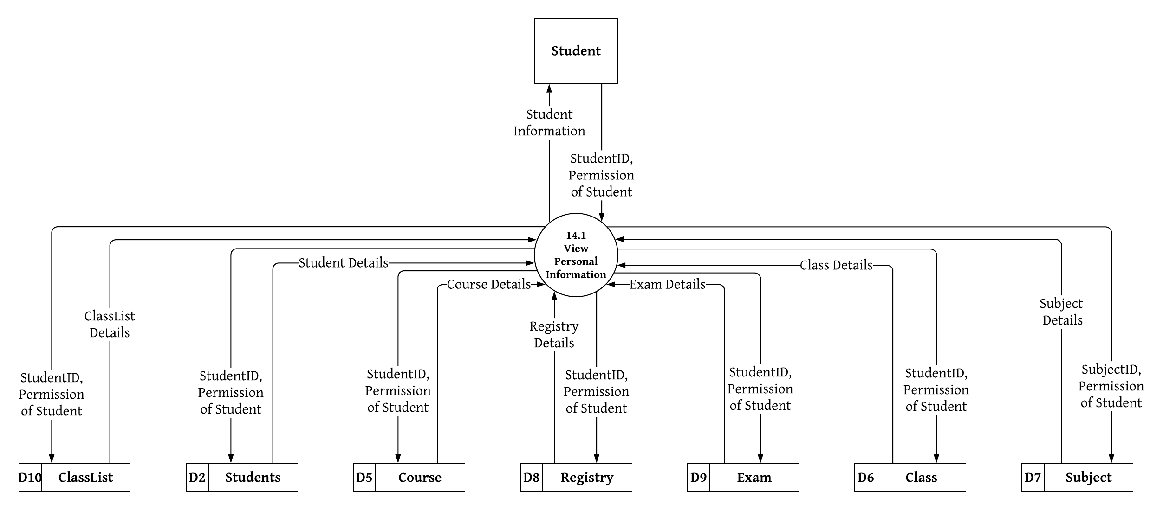

Slide 47
Project Ref. No. | Project Title: | Activity Plan Prepared By: |  | Date of Preparation of Activity Plan:
Task | Description | Planned Start Date | Actual Start Date | Actual Days | Teams Members Names | Status
1 | Form 3 (Project Plan) | 10-Sep-2019 | 12-Sep-2019 | 3 | Phạm Hoàng Tâm | Completed 100%
2 | Form 6 (ER) | 13-Sep-2019 | 16-Sep-2019 | 4 |  | Completed 100%
3 | Form 5 (Interface Design) | 17-Sep-2019 | 19-Sep-2019 | 3 |  | Completed 100%
4 | Form 7(DFD) | 20-Sep-2019 | 23-Sep-2019 | 4 |  | Completed 100%
5 | Form 9 (Task Sheet) | 10-Sep-2019 | 17-Sep-2019 | 37 |  | Completed 100%
6 | Manage Students | 24-Sep-2019 | 27-Sep-2019 | 4 |  | Completed 100%
7 | Manage Certificate | 28-Sep-2019 | 2-Oct-2019 | 5 |  | Completed 100%
8 | Manage Authentication | 3-Oct-2019 | 4-Oct-2019 | 4 |  | Completed 100%
9 | Manage Admin&CC | 5-Oct-2019 | 8-Oct-2019 | 4 |  | Completed 100%
10 | Manage issued certificate | 9-Oct-2019 | 11-Oct-2019 | 3 |  | Completed 100%
11 | Manage Report | 11-Oct-2019 | 12-Oct-2019 | 3 |  | Completed 100%
12 | Search and Verify Student Profile | 12-Oct-2019 | 13-Oct-2019 | 2 |  | Completed 100%
13 | Form 2B (CRS) | 10-Sep-2019 | 12-Sep-2019 | 3 | Nguyễn Trường Giang | Completed 100%
14 | Form 5 (Interface Design) | 13-Sep-2019 | 15-Sep-2019 | 3 |  | Completed 100%
15 | Form 7 (DFD) | 16-Sep-2019 | 19-Sep-2019 | 4 |  | Completed 100%
16 | Form 8 (Coding Standards) | 19-Sep-2019 | 20-Sep-2019 | 2 |  | Completed 100%
17 | Manage Course | 20-Sep-2019 | 27-Sep-2019 | 8 |  | Completed 100%
18 | Manage Exam | 28-Sep-2019 | 10-Sep-2019 | 13 |  | Completed 100%
19 | Manage Subject | 9-Oct-2019 | 13-Oct-2019 | 5 |  | Completed 100%
20 | Form 2A (CRS) | 10-Sep-2019 | 12-Sep-2019 | 3 | Nghiêm Anh Tú | Completed 80%
21 | Form 5 (Interface Design) | 17-Sep-2019 | 19-Sep-2019 | 3 |  | Completed 80%
22 | Form 7 (DFD) | 20-Sep-2019 | 23-Sep-2019 | 4 |  | Completed 80%
23 | Mange Grade | 24-Sep-2019 | 2-Oct-2019 | 9 |  | Completed 90%
24 | Manage Teachers | 3-Oct-2019 | 13-Oct-2019 | 11 |  | Completed 90%
25 | Form 1 (Problem Definition) | 10-Sep-2019 | 12-Sep-2019 | 3 | Trần Một Em | Completed 100%
26 | Form 4 (GUI Standards) | 13-Sep-2019 | 16-Sep-2019 | 4 |  | Completed 100%
27 | Form 7 (DFD) | 17-Sep-2019 | 19-Sep-2019 | 3 |  | Completed 100%
28 | Form 5 (Interface Design) | 20-Sep-2019 | 23-Sep-2019 | 4 |  | Completed 100%
 |  |  |  |  |  | Completed 100%
29 | Manage Class | 24-Sep-2019 | 30-Sep-2019 | 7
30 | Manage Teaching | 1-Oct-2019 | 6-Oct-2019 | 6 |  | Completed 100%
31 | Manage Personal Account | 7-Oct-2019 | 13-Oct-2019 | 7
 |  |  |  |  |  | Completed 100%

Slide 48
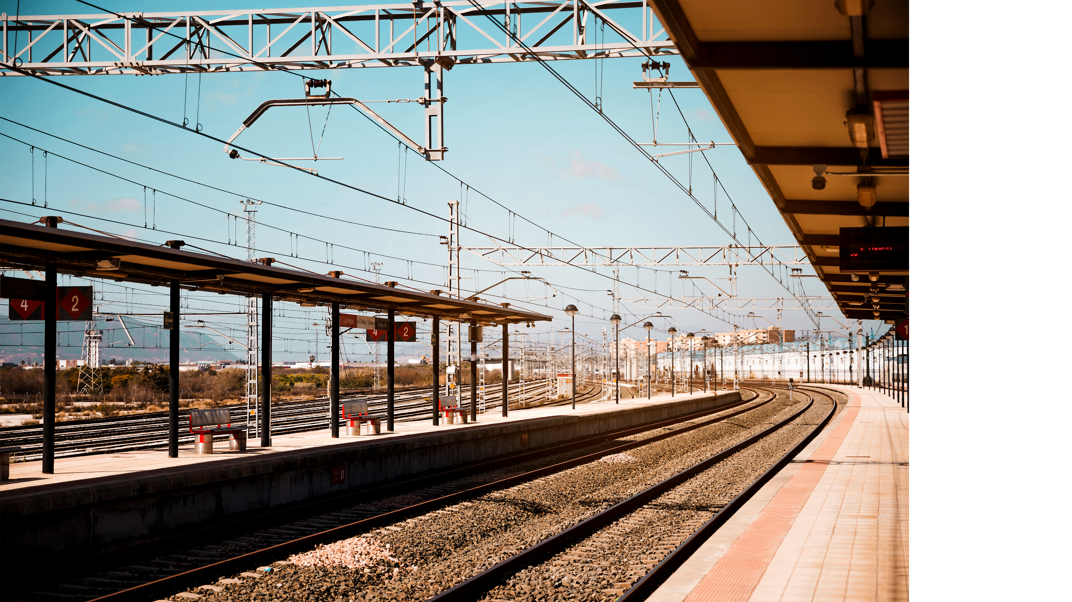
THANKS FOR LISTENING

